Slide 1
Course – DBMS
Course Instructor
Dr. K. SUBRAHMANYAM
Department of CSE, KL UNIVERSITY

Slide 2
Instruction to Students
Apart from the contents presented in the slides students should read through the text book also.

Slide 3
Unit 4
Transaction Processing, Concurrency Control and Recovery

Slide 4
Why you should Learn Transaction Processing in Database ?
What is Transaction ?

Slide 5

Transactions : Introduction
Example: Bank database application
Consider Ram and Shyam has an account in SBI bank at Basvangudi branch.
ACCOUNTS
Account Number | Name | Balance
501 | Ram | 150
502 | Shyam | 100

Slide 6
Transactions : Introduction
Example: Bank database application
Consider Ram and Shyam has an account in SBH bank at KLU branch.
ACCOUNTS
Account Number | Name | Balance
501 | Ram | 150
502 | Shyam | 100
Transaction:
Transfer Rs. 100 from Ram account to Shyam account.

Slide 7
Transactions : Introduction
Example: Bank database application
Consider Ram and Shyam has an account in SBH bank at KLU branch.
ACCOUNTS
Account Number | Name | Balance
501 | Ram | 150
502 | Shyam | 100
Transaction:
Transfer Rs. 100 Ram account to Shyam account.
Question:
What are the SQL statement to be executed
to perform the above transaction ?

Slide 8
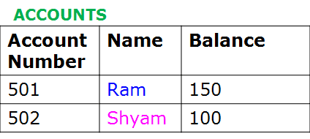
Transactions : Introduction
Example: Bank database application
Consider Ram and Shyam has an account in SBH bank at KLU branch.
Transaction: Transfer Rs. 100 Ram account to Shyam account.
Subtract Rs. 100/- from Ram account
update ACCOUNTS
set Balance =Balance-100
where AccountNumber=501;

Slide 9
Transactions : Introduction
Example: Bank database application
Consider Ram and Shyam has an account in SBH bank at KLU branch.
Transaction: Transfer Rs. 100 Ram account to Shyam account.
Subtract Rs. 100/- from Ram account
Add Rs. 100/- to Shyam account
update ACCOUNTS
set Balance =Balance-100
where AccountNumber=501;
update ACCOUNTS
set Balance =Balance+100
where AccountNumber=502;

Slide 10

Transactions : Introduction
Example: Bank database application
Consider Ram and Shyam has an account in SBH bank at KLU branch.
Transaction: Transfer Rs. 100 Ram account to Shyam account.
Subtract Rs. 100/- from Ram account
Add Rs. 100/- to Shyam account
update ACCOUNTS
set Balance =Balance-100
where AccountNumber=501;
update ACCOUNTS
set Balance =Balance+100
where AccountNumber=502;

Slide 11
Transactions : Introduction
Example: Bank database application
Consider Ram and Shyam has an account in SBH bank at KLU branch.
Transaction: Transfer Rs. 100 Ram account to Shyam account.
Subtract Rs. 100/- from Ram account
Add Rs. 100/- to Shyam account
Update ACCOUNTS
Set Balance =Balance-100
Where AccountNumber=501;
Update ACCOUNTS
Set Balance =Balance+100
Where AccountNumber=502;
FIRST
SECOND
Question:
What will be the status of ACCOUNTS table say if FIRST Update SQL
statement has been executed but SECOND Update SQL statement
has not been executed because of electricity failure on the computer system.

Slide 12
Transactions : Introduction
Example: Bank database application
Consider Ram and Shyam has an account in SBH bank at KLU branch.
Transaction: Transfer Rs. 100 Ram account to Shyam account.
Subtract Rs. 100/- from Ram account
Add Rs. 100/- to Shyam account
Update ACCOUNTS
Set Balance =Balance-100
Where AccountNumber=501;
Update ACCOUNTS
Set Balance =Balance+100
Where AccountNumber=502;
FIRST
SECOND
Question:
What will be the status of ACCOUNTS table say if SECOND Update SQL
statement has been executed but FIRST Update SQL statement
has not been executed because of electricity failure on the computer system.

Slide 13
Transactions : Introduction
Example: Bank database application
Consider Ram and Shyam has an account in SBH bank at KLU branch.
Transaction: Transfer Rs. 100 Ram account to Shyam account.
Subtract Rs. 100/- from Ram account
Add Rs. 100/- to Shyam account
Update ACCOUNTS
Set Balance =Balance-100
Where AccountNumber=501;
Update ACCOUNTS
Set Balance =Balance+100
Where AccountNumber=502;
FIRST
SECOND
SOLUTION:
Both FIRST and SECOND Update SQL statements should be executed successfully
for transaction to complete
In situations when any one of the UPDATE SQL statements i.e., FIRST or SECOND
has been executed then transaction should be aborted i.e., in ACCOUNTS
table Balance column should not be changed

Slide 14
Demonstration
Placing Transaction in between START TRANSACTION and COMMIT.

Slide 15
Demonstration
DROP TABLE IF EXISTS accounts;
CREATE TABLE accounts ( account_id INT PRIMARY KEY, owner VARCHAR(30), balance FLOAT) ;
INSERT INTO accounts VALUES (501, 'Ram', 150.0);
INSERT INTO accounts VALUES (502, 'Shyam', 100.0);
select * from accounts;

Slide 16
Demonstration
use bank;
START TRANSACTION;
UPDATE accounts SET balance = balance - 100 WHERE Name = 'Ram';
UPDATE accounts SET balance = balance + 100 WHERE Name = 'Shyam';
COMMIT;
select * from accounts;
User 1

Slide 17
Demonstration
use bank;
START TRANSACTION;
UPDATE accounts SET balance = balance - 100 WHERE Name = 'Ram';
UPDATE accounts SET balance = balance + 100 WHERE Name = 'Shyam';
COMMIT;
select * from accounts;
User 1

Slide 18
Demonstration
Bank database
use bank;
START TRANSACTION;
UPDATE accounts SET balance = balance - 100 WHERE owner = 'Ram';
UPDATE accounts SET balance = balance + 100 WHERE owner = 'Shyam';
COMMIT;
User 1
Question:
What will be the balance of Ram
and Shyam when User 2 executes
Select statement on accounts table
Use bank;
select * from accounts;
User 2

Slide 19
Demonstration
Bank database
use bank;
START TRANSACTION;
UPDATE accounts SET balance = balance - 100 WHERE owner = 'Ram';
UPDATE accounts SET balance = balance + 100 WHERE owner = 'Shyam';
COMMIT;
User 1
Use bank;
select * from accounts;
User 2

Slide 20
Demonstration
Bank database
use bank;
START TRANSACTION;
UPDATE accounts SET balance = balance - 100 WHERE owner = 'Ram';
UPDATE accounts SET balance = balance + 100 WHERE owner = 'Shyam';
COMMIT;
User 1
Question:
What will be the balance of Ram
and Shyam when User2 executes
Select statement on accounts table after
User1 has executed the set statements
mentioned above for him
Use bank;
select * from accounts;
User 2

Slide 21
Demonstration
Bank database
use bank;
START TRANSACTION;
UPDATE accounts SET balance = balance - 100 WHERE owner = 'Ram';
UPDATE accounts SET balance = balance + 100 WHERE owner = 'Shyam';
COMMIT;
User1
Changes done by User1
Will not be seen by User2
because User1 has not completed
the transaction i.e
COMMIT statement
has not been executed by User1
Use bank;
select * from accounts;
User2

Slide 22
Transactions
Example:
Transaction: Transfer Rs. 100 from Ram account to Shyam account.
UPDATE accounts SET balance = balance - 100 WHERE owner = 'Ram';
UPDATE accounts SET balance = balance + 100 WHERE owner = 'Shyam';
Above two Update statements must run, or neither must run. You cannot
have the money being transferred out of one person's account, and then
'disappearing' if for some reason the second query fails. Both these queries
form one transaction.
A transaction is simply a number of individual queries that are
grouped together in between START TRANSACTION and COMMIT
statement.
START TRANSACTION
UPDATE accounts SET balance = balance - 100 WHERE owner = 'Ram';
UPDATE accounts SET balance = balance + 100 WHERE owner = 'Shyam';
COMMIT

Slide 23
Transactions : Basic Definition
A transaction (“TXN”) is a sequence of one or more operations (reads or writes) which reflects a single real-world transition.
In the real world, a TXN either happened completely or not at all
Examples:
Transfer money between accounts
Purchase a group of products
Register for a class (either waitlist or allocated)
START TRANSACTION
UPDATE Product SET Price = Price – 1.99 WHERE pname = ‘Gizmo’
COMMIT

Slide 24
Transactions in SQL
In “ad-hoc” SQL:
Default: each statement = one transaction
In a program, multiple statements can be grouped together as a transaction:
START TRANSACTION
UPDATE Bank SET amount = amount – 100 WHERE Name = ‘Ram’
UPDATE Bank SET amount = amount + 100 WHERE Name = ‘Shyam’
COMMIT

Slide 25
Model of Transaction for 15CS4DCDBM
Note: For 15CS4DCDBM, we assume that the DBMS only sees reads and writes to data
User may do much more
In real systems, databases do have more info...

Slide 26
Model of Transaction: Read-Write Operations
read_item(X): Reads a database item named X into a program variable. To simplify our notation, we assume that the program variable is also named X.
write_item(X): Writes the value of program variable X into the database item named X.

Slide 27
Model of Transaction: Read-Write Operations
READ AND WRITE OPERATIONS:
Basic unit of data transfer from the disk to the computer main memory is one block. In general, a data item (what is read or written) will be the field of some record in the database, although it may be a larger unit such as a record or even a whole block.
read_item(X) command includes the following steps:
Find the address of the disk block that contains item X.
Copy that disk block into a buffer in main memory (if that disk block is not already in some main memory buffer).
Copy item X from the buffer to the program variable named X.

Slide 28
Model of Transaction: Read Operations
Example of transaction Read Operation: read(balance)
select balance from accounts;

Slide 29
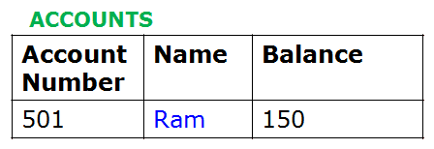
Model of Transaction: Read Operations
Example of transaction Read Operation: read(balance)
select balance from accounts;
Step 1
Find address
Of the disk
Block containing
Balance
Hard Disk
Block of
Memory

Slide 30
Model of Transaction: Read Operations
Example of transaction Read Operation: read(balance)
select balance from accounts;
Step 1
Find address
Of the disk
Block containing
Balance
Main memory
Hard Disk
buffer
150
Step 2
Copy
Disk block
into buffer of
Main memory
Block of
Memory

Slide 31
Model of Transaction: Read Operations
Example of transaction Read Operation: read(balance)
select balance from accounts;
Step 1
Find address
Of the disk
Block containing
Balance
Main memory
Hard Disk
buffer
150
Step 2
Copy
Disk block
into buffer of
Main memory
Step 3
Copy from
buffer to
Program
variable
balance
Block of
Memory
150
balance
Program variable

Slide 32
Model of Transaction: Read-Write Operations
READ AND WRITE OPERATIONS (contd.):
write_item(X) command includes the following steps:
Find the address of the disk block that contains item X.
Copy that disk block into a buffer in main memory (if that disk block is not already in some main memory buffer).
Copy item X from the program variable named X into its correct location in the buffer.
Store the updated block from the buffer back to disk (either immediately or at some later point in time).

Slide 33
Model of Transaction: Read-Write Operations
Example of transaction write Operation: write(balance)
Update accounts set balance=balance-100 where Name=‘Ram’;

Slide 34
Model of Transaction: Read-Write Operations
Example of transaction write Operation: write(balance)
Update accounts set balance=balance-100 where Name=‘Ram’;
Step 1
Find address
Of the disk
Block containing
Balance
Main memory
Hard Disk
buffer
150
Step 2
Copy
Disk block
into buffer of
Main memory
Step 3
Copy from
buffer to
Program
variable
balance
Block of
Memory
150 -100
balance
Program variable

Slide 35
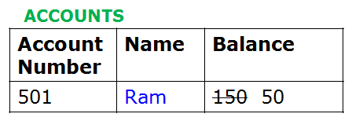
Model of Transaction: Read-Write Operations
Example of transaction write Operation: write(balance)
Update accounts set balance=balance-100 where Name=‘Ram’;
Step 1
Find address
Of the disk
Block containing
Balance
Main memory
Hard Disk
buffer
150 50
Step 3
Copy from
buffer to
Program
variable
balance
Block of
Memory
Step 4
Copy
Program variable
into buffer
150 -100
balance
Program variable

Slide 36
Model of Transaction: Read-Write Operations
Example of transaction write Operation: write(balance)
Update accounts set balance=balance-100 where Name=‘Ram’;
Step 1
Find address
Of the disk
Block containing
Balance
Main memory
Hard Disk
buffer
150 50
Step 5
Copy
From buffer
To hard disk
Step 3
Copy from
buffer to
Program
variable
balance
Block of
Memory
Step 4
Copy
Program variable
into buffer
150 -100
balance
Program variable

Slide 37
Problems with Concurrent Execution
What is Concurrent Execution ?
When Multiple users trying to access same database record in an uncontrolled manner.
Problems with Concurrent execution
Lost Update Problem
Temporary Update (or Dirty Read) Problem
Incorrect Summary Problem
Unrepeatable Read

Slide 38
To Understand problems with concurrent executions
Consider an example of Train Reservation System
Train Reservation Database
Source | Destination | Train Name | Start Time | Start Date | Number of Seats Reserved
Bangalore | Mysore | Tippu Express | 15:00 | 25-3-2016 | 80
Bangalore | Mysore | Chamundi Express | 18:15 | 25-3-2016 | 70
Train Ticket Booking/Cancellation Software
User1
User2

Slide 39
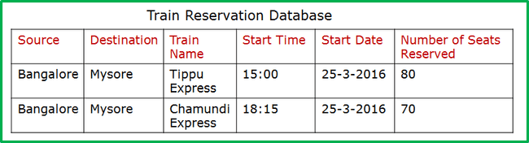
To Understand problems with concurrent executions
Consider an example of Train Reservation System
Train Ticket Booking/Cancellation Software
User1
User2
User1
1.Wants to cancel 5 seats on Tippu express
2.Wants to reserve 5 seats on Chamundi express
User2
1.Wants to reserve 4 seats on Tippu
express

Slide 40
To Understand problems with concurrent executions
Consider an example of Train Reservation System
reservation
table
Train Ticket Booking/Cancellation Software
User1
User2
User1
1.Wants to cancel 5 seats on Tippu express
2.Wants to reserve 5 seats on Chamundi express
Update reservation set seats=seats-5
Where TrainName=‘TippuExpress’;
Update reservation set seats=seats+5
Where TrainName=‘ChamundiExpress’;
User2
1.Wants to reserve 4 seats on Tippu
Express
Update reservation set seats=seats+4
Where TrainName=‘TippuExpress’;

Slide 41
To Understand problems with concurrent executions
Train Ticket Booking/Cancellation Software
User1
User2
User1
1.Wants to cancel 5 seats on Tippu express
2.Wants to reserve 5 seats on Chamundi express
Read(TippuSeats)
TippuSeats=TippuSeats-5
Write(TippuSeats)
Read(ChamundiSeats)
ChamundiSeats=ChamundiSeats+5
Write(ChamundiSeats)
User2
1.Wants to reserve 4 seats on Tippu
Express
Read(TippuSeats)
TippuSeats=TippuSeats+4
Write(TippuSeats)

Slide 42
To Understand problems with concurrent executions
Train Ticket Booking/Cancellation Software
User1
User2
Transaction1
Read(TippuSeats)
TippuSeats=TippuSeats-5
Write(TippuSeats)
Read(ChamundiSeats)
ChamundiSeats=ChamundiSeats+5
Write(ChamundiSeats)
Transaction2
Read(TippuSeats)
TippuSeats=TippuSeats+4
Write(TippuSeats)
Question
What will be the total number of seats on Tippu express and
Chamundi express if first User1 executes Transaction1 and then User2
Executes Transaction2

Slide 43
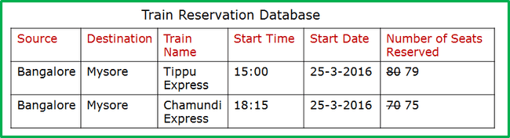
To Understand problems with concurrent executions
Train Ticket Booking/Cancellation Software
User1
User2
Transaction1
Read(TippuSeats)
TippuSeats=TippuSeats-5
Write(TippuSeats)
Read(ChamundiSeats)
ChamundiSeats=ChamundiSeats+5
Write(ChamundiSeats)
Transaction2
Read(TippuSeats)
TippuSeats=TippuSeats+4
Write(TippuSeats)
Answer
Tippu express seats: 79
Chamundi express seats: 75

Slide 44
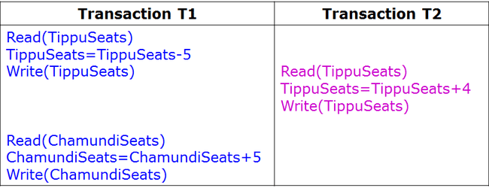
Non-interleaved vs Interleaved transactions
Non-interleaved transaction (or Serial transaction): In this case first
completely transaction T1 gets executed and then transaction T2 gets executed
Transaction1
Read(TippuSeats)
TippuSeats=TippuSeats-5
Write(TippuSeats)
Read(ChamundiSeats)
ChamundiSeats=ChamundiSeats+5
Write(ChamundiSeats)
Transaction2
Read(TippuSeats)
TippuSeats=TippuSeats+4
Write(TippuSeats)
Interleaved transaction (or Non-Serial or Concurrent):
First, Part of Transaction T1 gets executed,
second Transaction T2 gets executed and third
remaining part of transaction T1 gets executed

Slide 45
Lost Update Problem: Example
Train Ticket Booking/ Cancellation Software
User2
User1
Transaction T1 | Transaction T2
Read(TippuSeats) TippuSeats=TippuSeats-5 Write(TippuSeats) Read(ChamundiSeats) ChamundiSeats=ChamundiSeats+5 Write(ChamundiSeats) | Read(TippuSeats) TippuSeats=TippuSeats+4 Write(TippuSeats)

Slide 46
Problems with Concurrent Execution
Lost Update Problem
This occurs when two transactions that access the same database items have their operations interleaved in a way that makes the value of some database item incorrect.

Slide 47
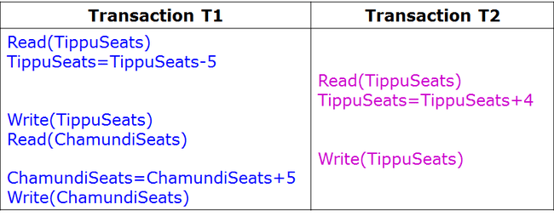
Lost Update Problem: Example
Train Ticket Booking/ Cancellation Software
User2
User1
Question
What will be the total number of seats on Tippu express and
Chamundi express after execution of the above set Transaction statements

Slide 48
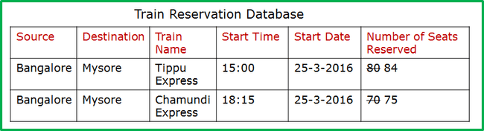
Lost Update Problem: We are Loosing update
Train Ticket Booking/ Cancellation Software
User2
User1
Answer
Tippu express seats: 84 <- INCORRECT
Chamundi express seats: 75
Update made by one Transaction
is overridden by another Transaction

Slide 49
Problems with Concurrent Execution
2. The Dirty Read (or Temporary Update) Problem
This occurs when one transaction updates a database item and then the transaction fails for some reason.
The updated item is accessed by another transaction before it is changed back to its original value.

Slide 50
Dirty Read (or Temporary Update ) Problem
Train Ticket Booking/ Cancellation Software
User2
User1
Transaction T1 | Transaction T2
Read(TippuSeats) TippuSeats=TippuSeats-5 Write(TippuSeats) UNDO or FAIL or ROLLBack Read(ChamundiSeats) ChamundiSeats=ChamundiSeats+5 Write(ChamundiSeats) | Read(TippuSeats) TippuSeats=TippuSeats+4 Write(TippuSeats)

Slide 51
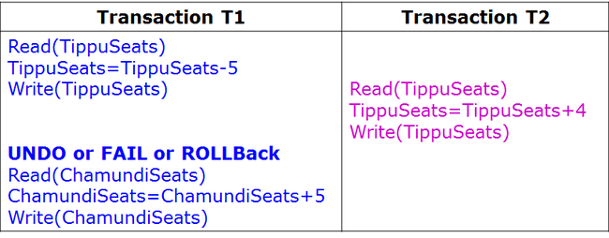
Dirty Read (or Temporary Update ) Problem
Train Ticket Booking/ Cancellation Software
User2
User1
Question
What will be the total number of seats on Tippu express and
Chamundi express after execution of the above set Transaction statements

Slide 52
Dirty Read (or Temporary Update ) Problem
Train Ticket Booking/ Cancellation Software
User2
User1
Answer
Tippu express seats: 80 <- INCORRECT
Chamundi express seats: 75
“Dirty read” / Reading uncommitted data
Occurring with / because of a write conflict

Slide 53
Example
Train Ticket Booking/ Cancellation Software
User2
User1
Answer
Tippu express seats: 80 <- INCORRECT
Chamundi express seats: 75
“Dirty read” / Reading uncommitted data
Occurring with / because of a write conflict

Slide 54
Problems with Concurrent Execution
What is Concurrent Execution ?
When Multiple users trying to access same database record in an uncontrolled manner.
Problems with Concurrent execution
Lost Update Problem
Temporary Update (or Dirty Read) Problem
Incorrect Summary Problem
Unrepeatable Read

Slide 55
Lost Update Problem: We are Loosing update
Train Ticket Booking/ Cancellation Software
User2
User1
Answer
Tippu express seats: 84 <- INCORRECT
Chamundi express seats: 75
Update made by one Transaction
is overridden by another Transaction

Slide 56
Dirty Read (or Temporary Update ) Problem
Train Ticket Booking/ Cancellation Software
User2
User1
Answer
Tippu express seats: 80 <- INCORRECT
Chamundi express seats: 75
“Dirty read” / Reading uncommitted data
Occurring with / because of a write conflict

Slide 57
Problems with Concurrent Execution
What is Concurrent Execution ?
When Multiple users trying to access same database record in an uncontrolled manner.
Problems with Concurrent execution
Lost Update Problem
Temporary Update (or Dirty Read) Problem
Incorrect Summary Problem
Unrepeatable Read

Slide 58
Example
User1
User3
Transaction T1
Read(TippuSeats) TippuSeats=TippuSeats-5 Write(TippuSeats) Read(ChamundiSeats) ChamundiSeats=ChamundiSeats+5 Write(ChamundiSeats)
Transaction T3
sum:=0 Read(TippuSeats) sum=sum+TippuSeats Read(ChamundiSeats) sum=sum+ChamundiSeats

Slide 59
Example
User1
User3
Transaction T1
Read(TippuSeats) TippuSeats=TippuSeats-5 Write(TippuSeats) Read(ChamundiSeats) ChamundiSeats=ChamundiSeats+5 Write(ChamundiSeats)
Transaction T3
sum:=0 Read(TippuSeats) sum=sum+TippuSeats Read(ChamundiSeats) sum=sum+ChamundiSeats
Question
Say if first Transaction T1 has been executed first and second Transaction T3 has been executed then,
What will be the total number of seats on Tippu express & Chamundi express; and sum value

Slide 60
Example
User1
User3
Transaction T1
Read(TippuSeats) TippuSeats=TippuSeats-5 Write(TippuSeats) Read(ChamundiSeats) ChamundiSeats=ChamundiSeats+5 Write(ChamundiSeats)
Transaction T3
sum:=0 Read(TippuSeats) sum=sum+TippuSeats Read(ChamundiSeats) sum=sum+ChamundiSeats
Answer
Tippu express seats=75
Chamundi express seats=75
sum=150

Slide 61
Problems with Concurrent Execution
3. The Incorrect Summary Problem
If one transaction is calculating an aggregate summary function on a number of records while other transactions are updating some of these records, the aggregate function may calculate some values before they are updated and others after they are updated.

Slide 62
Incorrect Summary Problem
User1
User3
Transaction T1 | Transaction T3
Read(TippuSeats) TippuSeats=TippuSeats-5 Write(TippuSeats) Read(ChamundiSeats) ChamundiSeats=ChamundiSeats+5 Write(ChamundiSeats) | sum:=0 Read(TippuSeats) sum=sum+TippuSeats Read(ChamundiSeats) sum=sum+ChamundiSeats

Slide 63
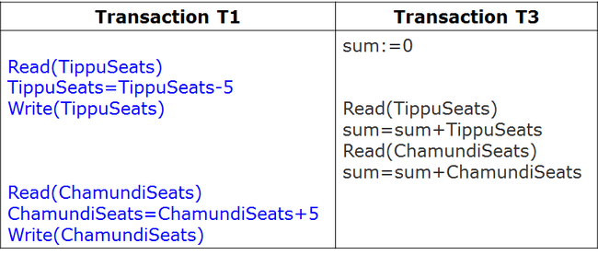
Incorrect Summary Problem
User1
User3
Question
What will be the total number of seats on Tippu express & Chamundi express; and sum value when above set of transactions statements are executed

Slide 64
Incorrect Summary Problem
User1
User3
Answer
Tippu express seats=75
Chamundi express seats=75
Sum=145 <- INCORRECT

Slide 65
Problems with Concurrent Execution
What is Concurrent Execution ?
When Multiple users trying to access same database record in an uncontrolled manner.
Problems with Concurrent execution
Lost Update Problem
Temporary Update (or Dirty Read) Problem
Incorrect Summary Problem
Unrepeatable Read

Slide 66
Unrepeatable Read
Unrepeatable Read occurs, if transaction T1 reads an item twice and the item is changed by an another transaction T2 between two reads hence T1 finds two different values on it's two reads.
Example: If during train reservation, a user inquires about seat availability on several trains. When user decides on a particular train, the transaction reads the number of seats on that train a second time before completing the reservation.

Slide 67
Unrepeatable Read: Example
Transaction T1 | Transaction T2
Read(TippuSeats) Read(TippuSeats) | Read(TippuSeats) TippuSeats=TippuSeats+4 Write(TippuSeats)
First time when Transaction T1 reads, TippuSeats value
will be 80 but second time when the same Transaction T1
Reads, TippuSeats value will be 84. T1 is seeing two different values
for same item TippuSeats

Slide 68
Why Concurrency Control is needed ?
To avoid following Problems
Lost Update Problem
Temporary Update (or Dirty Read) Problem
Incorrect Summary Problem
Unrepeatable Read

Slide 69
Next we will Understand Schedules
Schedule is a sequence of operations of various transactions

Slide 70
Transaction Schedules
Example to Understand Transaction Schedules
Consider TWO transactions T1 and T2
T1: Cancel FIVE seats on Tippu express
Read(TippuSeats)
TippuSeats=TippuSeats-5
Write(TippuSeats)
T2: Reserve FOUR seats on Chamundi express
Read(ChamundiSeats)
ChamundiSeats=ChamundiSeats+4
Write(ChamundiSeats)

Slide 71
Transaction Schedules
Schedule 1: T1, T2
T1:Read(TippuSeats)
T1:TippuSeats=TippuSeats-5
T1:Write(TippuSeats)
T2:Read(ChamundiSeats)
T2:ChamundiSeats=ChamundiSeats+4
T2:Write(ChamundiSeats)
Shorthand Notation
Schedule 1: T1, T2
R1, W1, R2,W2

Slide 72
Transaction Schedules
Schedule 1: T1, T2
Schedule 2: T2, T1
T1:Read(TippuSeats)
T1:TippuSeats=TippuSeats-5
T1:Write(TippuSeats)
T2:Read(ChamundiSeats)
T2:ChamundiSeats=ChamundiSeats+4
T2:Write(ChamundiSeats)
T2:Read(ChamundiSeats)
T2:ChamundiSeats=ChamundiSeats+4
T2:Write(ChamundiSeats)
T1:Read(TippuSeats)
T1:TippuSeats=TippuSeats-5
T1:Write(TippuSeats)
Shorthand Notation
Shorthand Notation
Schedule 1: T1, T2
Schedule 2: T2, T1
R1, W1, R2,W2
R2,W2, R1, W1

Slide 73
Different Possible Schedules for given set of transactions
Consider Two Transactions
T1: Cancel FIVE seats on Tippu express (R1, W1)
T2: Reserve four seats on Chamundi express (R2,W2)
Different possible schedules for the above two transactions are as follows:
Schedule 1 | R1, W1, R2,W2
Schedule 2 | R2,W2, R1, W1
Schedule 3 | R1, R2, W1,W2
Schedule 4 | R2, R1, W2, W1

Slide 74
Transaction Schedules
Consider Two Transactions
T1: Cancel FIVE seats on Tippu express (R1, W1)
T2: Reserve four seats on Chamundi express (R2,W2)
Different possible schedules for the above two transactions are as follows:
Schedule 1 | R1, W1, R2,W2
Schedule 2 | R2,W2, R1, W1
Schedule 3 | R1, R2, W1,,W2
Schedule 4 | R2, R1, W2, W1
Following are not feasible schedules because they do not
preserve the order of operations of the individual Transactions
W1, R1, W2, R2
W2, R2, W1, R1

Slide 75
Transaction Schedules
Consider Two Transactions
T1: Cancel FIVE seats on Tippu express (R1, W1)
T2: Reserve four seats on Chamundi express (R2,W2)
Different possible schedules for the above two transactions are as follows:
Schedule 1 | R1, W1, R2,W2
Schedule 2 | R2,W2, R1, W1
Schedule 3 | R1, R2, W1,,W2
Schedule 4 | R2, R1, W2, W1
Following are not feasible schedules because they do not
preserve the order of operations of the individual Transactions
W1, R1, W2, R2
W2, R2, W1, R1
W1, W2, R1, R2
W2, W1, R2, R1

Slide 76
Serial Schedule vs Interleaved Schedule
Consider Two Transactions
T1: Cancel FIVE seats on Tippu express
T2: Reserve four seats on Chamundi express
Different possible schedules for the above two transactions are as follows:
Schedule 1 | R1, W1, R2,W2
Schedule 2 | R2,W2, R1, W1
Schedule 3 | R1, R2, W1,W2
Schedule 4 | R2, R1, W2, W1
Schedule 1 & 2 are
Serial Schedule
Schedule 3 & 4 are
Interleaved or Parallel
Schedule
Note:
Serial Schedule: A schedule in which the different transactions are NOT interleaved (i.e., transactions are executed from start to finish one-by-one)
-The result of Interleaved Schedule should be equivalent Some serial schedule

Slide 77
Question
What will be the total number of serial schedules that can occur if there are m Transactions i.e., T1, T2,….Tm

Slide 78
Question
What will be the total number of serial schedules that can occur if there are m Transactions i.e., T1, T2,….Tm
Answer: m! (m * (m-1) * (m-2)…..*1)
Example:
Two Transactions T1 & T2
Two (2!) Serial Schedules:
T1, T2
T2,T1
Three Transactions T1 , T2 & T3
Six (3!) Serial Schedules :
T1,T2,T3
T1,T3,T2
T2,T1,T3
T2,T3,T1
T3,T1,T2
T3,T2,T1
Notes:
In general, given m transactions with number of operations n1, n2, ..., nm, the number of possible schedules is: (n1 + n2 + ... + nm)! / (n1! * n2! * ... * nm!), where ! is the factorial function. In our case, m =2 and n1 = 5 and n2 = 3, so the number of possible schedules is:(5+3)! / (5! * 3!) = 8*7*6*5*4*3*2*1/ 5*4*3*2*1*3*2*1 = 56.

Slide 79
Scheduling Definitions
A serial schedule is one that does not interleave the actions of different transactions
A and B are equivalent schedules if, for any database state, the effect on DB of executing A is identical to the effect of executing B
A serializable schedule is a schedule that is equivalent to some serial execution of the transactions.
The word “some” makes this definition powerful and tricky!

Slide 80
Problem to Solve
To check whether given schedule is serializable or not

Slide 81
Example- consider two TXNs:
T1: START TRANSACTION
UPDATE Accounts SET Amt = Amt + 100
WHERE Name = ‘A’
UPDATE Accounts SET Amt = Amt - 100
WHERE Name = ‘B’
COMMIT
T2: START TRANSACTION
UPDATE Accounts SET Amt = Amt * 1.06
COMMIT
T2 credits both accounts with a 6% interest payment
T1 transfers Rs.100/- from B’s account to A’s account

Slide 82
Example- consider two Transactions (T1 and T2):
We can look at the transactions in a timeline view- serial execution:
T₁
A += 100
B -= 100
T₂
A *= 1.06
B *= 1.06
Time
T1 transfers Rs.100 from B’s account to A’s account
T2 credits both accounts with a 6% interest payment

Slide 83
Example- consider two Transactions (T1 and T2):
The transactions could occur in either order… DBMS allows!
T₁
A += 100
B -= 100
T₂
A *= 1.06
B *= 1.06
Time
T2 credits both accounts with a 6% interest payment
T1 transfers Rs.100/- from B’s account to A’s account

Slide 84
Starting Balance
Serial schedule T₁,T₂:
A | B
Rs.50 | Rs.200
T₁
A += 100
B -= 100
Result of Executing T1, T2
A | B
Rs.159 | Rs.106
T₂
A *= 1.06
B *= 1.06
Time
Starting Balance
A | B
Rs.50 | Rs.200
Serial schedule T₂,T1:
T₁
A += 100
B -= 100
Result of Executing T2,T1
A | B
Rs.153 | Rs.112
T₂
A *= 1.06
B *= 1.06
Time

Slide 85
Problem to Solve
Check whether the following schedule i.e., (A+=100, A*=1.06,
B-=100, B*=1.06) is Serializable ?
Serial schedule results:
Starting Balance
 | A | B
T₁,T₂ | Rs.159 | Rs.106
T₂,T₁ | Rs.153 | Rs.112
A | B
Rs.50 | Rs.200
Transaction Schedule
T₁
A += 100
B -= 100
T₂
A *= 1.06
B *= 1.06
Note:To check whether given schedule is serializable or not, we should check whether the given interleaved schedule result is equivalent to result of some serial schedule

Slide 86
Serializable, Yes
Starting Balance
Serial schedules:
A | B
Rs.50 | Rs.200
 | A | B
T₁,T₂ | Rs.159 | Rs.106
T₂,T₁ | Rs.153 | Rs.112
Transaction Schedule
T₁
A += 100
B -= 100
A | B
Rs.159 | Rs.106
T₂
A *= 1.06
B *= 1.06
Same as a serial schedule for all possible values of A, B = serializable

Slide 87
Problem to Solve
Check whether the following schedule i.e., (A+=100, A*=1.06,
B-=100, B*=1.06) is Serializable ?
Serial schedule results:
Starting Balance
 | A | B
T₁,T₂ | Rs.159 | Rs.106
T₂,T₁ | Rs.153 | Rs.112
A | B
Rs.50 | Rs.200
Transaction Schedule
T₁
A += 100
B -= 100
T₂
A *= 1.06
B *= 1.06
Note:To check whether given schedule is serializable or not, we should check whether the given interleaved schedule result is equivalent to result of some serial schedule

Slide 88
Serializable, No
Starting Balance
Serial schedules:
A | B
Rs.50 | Rs.200
 | A | B
T₁,T₂ | Rs.159 | Rs.106
T₂,T₁ | Rs.153 | Rs.112
Transaction Schedule
T₁
A += 100
B -= 100
A | B
Rs.159 | Rs.112
T₂
A *= 1.06
B *= 1.06
Not equivalent to any serializable schedule = not serializable

Slide 89
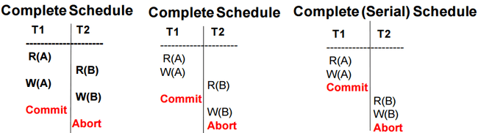
Complete Schedule
Complete Schedule: A schedule that contains either a commit or an abort action for EACH transaction
Note: consequently, a complete schedule will not contain any active
transactions at the end of the schedule

Slide 90
Next we will Understand
Conflicting operations in Schedules

Slide 91
Conflicting Operations in Schedules
Two operations in schedule are said to CONFLICT if they satisfy all three of the following conditions
If two operations belong to different transactions
If two operations access same data item
Among two operations at least one operation is write

Slide 92
Conflicting Operations in Schedules
Two operations in schedule are said to CONFLICT if they satisfy all three of the following conditions
If two operations belong to different transactions
If two operations access same data item
Among two operations at least one operation is write
Example: Consider two transactions
T1 with operations R1(X) and R1(Y)
T2 with operations W2(X) and R2(Z)
Consider the schedule as: R1(X), W2(X), R1(Y), R2(Z)
R1(X) | W2(X) | R1(Y) | R2(Z)
Conflict

Slide 93
Conflicting Operations in Schedules
Two operations in schedule are said to CONFLICT if they satisfy all three of the following conditions
If two operations belong to different transactions
If two operations access same data item
Among two operations at least one operation is write
Example: Consider two transactions
T1 with operations R1(X) and R1(Y)
T2 with operations W2(X) and R2(Z)
Consider the schedule as: R1(X), W2(X), R1(Y), R2(Z)
R1(X) | W2(X) | R1(Y) | R2(Z)
Conflict
Conflict
Conflict

Slide 94
Conflicting Operations in Schedules
Two operations in schedule are said to CONFLICT if they satisfy all three of the following conditions
If two operations belong to different transactions
If two operations access same data item
Among two operations at least one operation is write
Example: Consider two transactions
T1 with operations R1(X) and R1(Y)
T2 with operations W2(X) and R2(Z)
Consider the schedule as: R1(X), W2(X), R1(Y), R2(Z)
R1(X) | W2(X) | R1(Y) | R2(Z)
Conflict
Conflict
Conflict
Conflict

Slide 95
Conflicting Operations in Schedules
Two operations in schedule are said to CONFLICT if they satisfy all three of the following conditions
If two operations belong to different transactions
If two operations access same data item
Among two operations at least one operation is write
Example: Consider two transactions
T1 with operations R1(X) and R1(Y)
T2 with operations W2(X) and R2(Z)
Consider the schedule as: R1(X), W2(X), R1(Y), R2(Z)
R1(X) | W2(X) | R1(Y) | R2(Z)
Conflict

Slide 96
Conflicting Operations in Schedules
Two operations in schedule are said to CONFLICT if they satisfy all three of the following conditions
If two operations belong to different transactions
If two operations access same data item
Among two operations at least one operation is write
Example: Consider two transactions
T1 with operations R1(X) and R1(Y)
T2 with operations W2(X) and R2(Z)
Consider the schedule as: R1(X), W2(X), R1(Y), R2(Z)
R1(X) | W2(X) | R1(Y) | R2(Z)
Conflict

Slide 97
Conflicting Operations in Schedules
Two operations in schedule are said to CONFLICT if they satisfy all three of the following conditions
If two operations belong to different transactions
If two operations access same data item
Among two operations at least one operation is write
Example: Consider two transactions
T1 with operations R1(X) and R1(Y)
T2 with operations W2(X) and R2(Z)
Consider the schedule as: R1(X), W2(X), R1(Y), R2(Z)
Now only CONFLICTing operation in the given schedule which satisfy all three conditions is (R1(X), W2(X))
R1(X) | W2(X) | R1(Y) | R2(Z)
Conflict

Slide 98
Conflicting Operations in Schedules
Two operations in schedule are said to CONFLICT if they satisfy all three of the following conditions
If two operations belong to different transactions
If two operations access same data item
Among two operations at least one operation is write
Question:
Check which of the following schedules are having Conflicting operations
Schedule 1 | R1(X), W2(X), W3(X)
Schedule 2 | R1(X), R2(X), R3(X)
Schedule 3 | R1(X), W2(Y), R3(X)

Slide 99
Conflicting Operations in Schedules
Two operations in schedule are said to CONFLICT if they satisfy all three of the following conditions
If two operations belong to different transactions
If two operations access same data item
Among two operations at least one operation is write
Question:
Check which of the following schedules are having Conflicting operations
Schedule 1 | R1(X), W2(X), W3(X) | YES, because (R1(X), W2(X))
Schedule 2 | R1(X), R2(X), R3(X) | NO
Schedule 3 | R1(X), W2(Y), R3(X) | NO

Slide 100
Serializibility
What is Serializability ? – “Correctness Measure” of some Schedule
– Why is it useful? It answers the question: “Will an interleaved schedule execute correctly”
– i.e., a Serializable schedule will execute as correctly as serial schedule … but in an interleaved manner!
Example: Consider two transactions
T1 with operations
Read(X)
X=X-5
Write(X)
Read(Y)
Y=Y+5
Write(Y))
T2 with operations
Read(X)
X=X-4
Write(X)

Slide 101
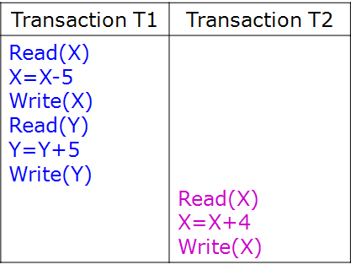
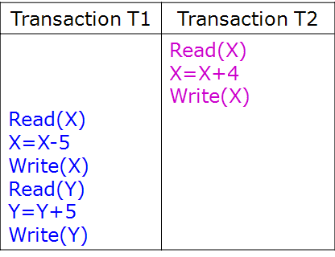
Serializibility
What is Serializability ? – “Correctness Measure” of some Schedule
– Why is it useful? It answers the question: “Will an interleaved schedule execute correctly”
– i.e., a Serializable schedule will execute as correctly as serial schedule … but in an interleaved manner!
Example: Consider two transactions
T1 with operations (Read(X); X=X-5,Write(X); Read(Y); Y=Y+5; Write(Y))
T2 with operations (Read(X), X=X-4,Write(X));
For this two Transactions (T1 & T2) two possible serial schedules are:
Serial schedule (T1, T2)
Serial schedule (T2, T1)
Order of
Execution
Of operations
Order of
Execution
Of operations

Slide 102
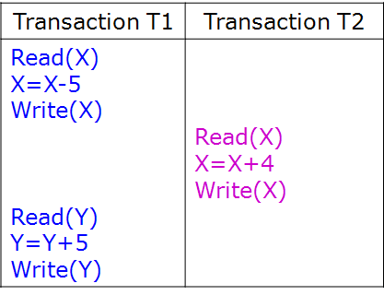
Serializibility
Serial schedule (T1, T2)
Serial schedule (T2, T1)
Order of
Execution
Of operations
Order of
Execution
Of operations
Non-Serial schedule which
is serializable because it is
equivalent to serial schedule (T1,T2)
Order of
Execution
Of operations

Slide 103
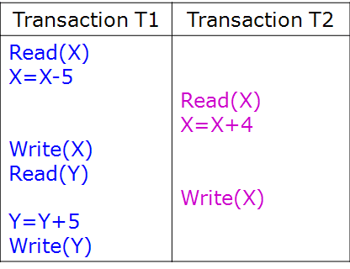
Serializibility
Serial schedule (T1, T2)
Serial schedule (T2, T1)
Order of
Execution
Of operations
Order of
Execution
Of operations
Non-Serial schedule which
is serializable because it is
equivalent to serial schedule (T1,T2)
Non-Serial schedule, but it is not
serializable because it is not
equivalent to any serial schedule
Order of
Execution
Of operations
Order of
Execution
Of operations

Slide 104
Characterizing Schedules based on Serializibility
Based on Serializability
Characterize which schedules are correct when concurrent transactions are executing.
Conflict Serializable Schedule
View Serializable Schedule

Slide 105
Conflict Serializibility Schedule
A schedule S is said to be conflict serializable if it is conflict equivalent to some serial schedule S’.
What is Conflict Equivalent ?
Two schedules are said to be conflict equivalent if the order of any two conflicting operations is the same in both schedules.

Slide 106
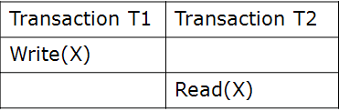
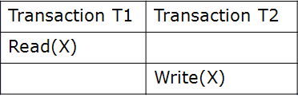
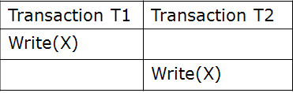
Conflict Serializibility Schedule
A schedule S is said to be conflict serializable if it is conflict equivalent to some serial schedule S’.
What is Conflict Equivalent ?
Two schedules are said to be conflict equivalent if the order of any two conflicting operations is the same in both schedules.
What are Conflicting Operations ?

Slide 107
Check whether the given Two schedules are conflict equivalent ?
Definition: Two schedules are said to be conflict equivalent if the order of any two conflicting operations is the same in both schedules.
Schedule S1
Schedule S2
T1 | T2
Read(A)
Read(B)
 | Write(A)
 | Write(B)
T1 | T2
Read(A)
 | Write(A)
Read(B)
 | Write(B)
Schedule S1: R1(A), R1(B), W2(A), W2(B)
Schedule S2: R1(A),W2(A), R1(B),W2(B)

Slide 108
Check whether the given Two schedules are conflict equivalent ?
Schedule S1
Schedule S2
T1 | T2
Read(A)
Read(B)
 | Write(A)
 | Write(B)
T1 | T2
Read(A)
 | Write(A)
Read(B)
 | Write(B)
Answer: Schedule S1 and S2 are conflict equivalent
Schedule 1 | R1(A), R1(B), W2(A),W2(B) | Conflict Operations R1(A) and W2(A) R1(B) and W2(B) | Schedule 1 and 2 are conflict equivalent because the order of conflict operations are same
Schedule 2 | R1(A),W2(A), R1(B),W2(B) | Conflict Operations R1(A) and W2(A) R1(B) and W2(B)

Slide 109
Check whether the given Two schedules are conflict equivalent ?
Definition: Two schedules are said to be conflict equivalent if the order of any two conflicting operations is the same in both schedules.
Schedule S1
Schedule S2
T1 | T2
 | Write(A)
 | Write(B)
Read(A)
Read(B)
T1 | T2
Read(A)
 | Write(A)
Read(B)
 | Write(B)
Schedule S1: W2(A), W2(B), R1(A), R1(B)
Schedule S2: R1(A),W2(A), R1(B),W2(B)

Slide 110
Check whether the given Two schedules are conflict equivalent ?
Schedule S1
Schedule S2
T1 | T2
 | Write(A)
 | Write(B)
Read(A)
Read(B)
T1 | T2
Read(A)
 | Write(A)
Read(B)
 | Write(B)
Answer: Schedule S1 and S2 are not conflict equivalent
Schedule 1 | W2(A),W2(B), R1(A), R1(B) | Conflict Operations W2(A) and R1(A) W2(B) and R1(B) | Schedule 1 and 2 are not conflict equivalent because the order of conflict operations are different in the schedules
Schedule 2 | R1(A),W2(A), R1(B),W2(B) | Conflict Operations R1(A) and W2(A) R1(B) and W2(B)

Slide 111
Problem to Solve
Check whether the following two schedules are conflict equivalent ?
Schedule 1
Schedule 2
T1 | T2
R(A) W(A) | R(A) W(A)
T1 | T2
R(A) W(A) | R(A) W(A)
T1 | T2
R(A) W(A) | R(A) W(A)
Schedule 1 | R1(A), W1(A), R2(A),W2(A) | Conflict Operations R1(A) and W2(A) W1(A) and R2(A) W1(A) and W2(A) | Schedule 1 and 2 are not conflict equivalent because the order of conflict operations are not same
Schedule 2 | R2(A), W2(A),R1(A), W1(A) | Conflict Operations W2(A) and R1(A) R2(A) and W1(A) W2(A) and W1(A)
Note:Two schedules are said to be conflict equivalent if the order of any two conflicting operations is the same in both schedules.

Slide 112
Problem to Solve
Check whether the following two schedules are conflict equivalent ?
Schedule 1
Schedule 3
T1 | T2
R(A) W(A) | R(A) W(A)
T1 | T2
R(A) W(A) | R(A) W(A)
Schedule 1 | R1(A), W1(A), R2(A),W2(A) | Conflict Operations
Schedule 3 | R1(A), R1(A), W2(A),W1(A) | Conflict Operations
Note:Two schedules are said to be conflict equivalent if the order of any two conflicting operations is the same in both schedules.

Slide 113
Testing for conflict-serializability of a schedule
Looks at only read_Item (X) and write_Item (X) operations
Constructs a precedence graph (serialization graph) - a graph with directed edges
An edge is created from Ti to Tj if one of the operations in Ti appears before a conflicting operation in Tj
The schedule is serializable if and only if the precedence graph has no cycles
Definition of Conflict Serializability Schedule:
A schedule S is said to be conflict serializable if it is conflict equivalent
to some serial schedule S’.

Slide 114
Algorithm Testing for conflict-serializability
Algorithm:
For each transaction Ti participating in schedule S, create a node labeled Ti in the precedence graph.
For each case in S where Tj executes a read_item(X) after Ti executes a write_item(X), create an edge (Ti→Tj) in the precedence graph.
For each case in S where Tj executes a write_item(X) after Ti executes a read_itern (X) ,create an edge (Ti→Tj) in the precedence graph.
For each case in S where Tj executes a write_item(X) after Ti executes a write_item(X), create an edge (Ti→Tj) in the precedence graph.
The schedule S is serializable if and only if the precedence graph has no cycles.

Slide 115
Problem To Solve
Construct precedence graph for the following schedule
Schedule S1
T1 | T2 | T3
 |  | Read(A)
 | Read(A)
 |  | Write(A)
Read(A)
Write(A)

Slide 116
Solution
Construct precedence graph for the following schedule
Schedule S1
T1 | T2 | T3
 |  | Read(A)
 | Read(A)
 |  | Write(A)
Read(A)
Write(A)
T1
A
T2
Given: Three Transactions
T1 with operations Read(A), Write(A)
T2 with operations Read(A)
T3 with operations Read(A), Write(A)
Schedule S1: R3(A), R2(A),W3(A), R1(A), W1(A)
A
A
T3

Slide 117
Problem To Solve
Construct precedence graph for the following schedule
Schedule S1
T1 | T2 | T3
Read(A)
 | Write(A)
Write(A)
 |  | Write(A)

Slide 118
Problem To Solve
Construct precedence graph for the following schedule
Schedule S1
T1 | T2 | T3
Read(A)
 | Write(A)
Write(A)
 |  | Write(A)
T1
A
T2
Given: Three Transactions
T1 with operations Read(A), Write(A)
T2 with operations Read(A)
T3 with operations Write(A)
Schedule S1: R1(A), W2(A), W1(A), W3(A)
A
A
A
T3

Slide 119
Problem To Solve
What is the Equivalent serial schedule for non-serial schedule S1:R3(A), R2(A),W3(A), R1(A), W1(A)

Slide 120
Problem To Solve
What is the Equivalent serial schedule for non-serial scheduleS1:R3(A), R2(A),W3(A), R1(A), W1(A)
T1
A
T2
Given: Three Transactions
T1 with operations Read(A), Write(A)
T2 with operations Read(A)
T3 with operations Read(A), Write(A)
Schedule S1: R3(A), R2(A),W3(A), R1(A), W1(A)
A
A
T3

Slide 121
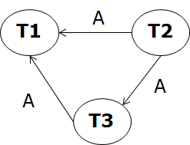
Problem To Solve
What is the Equivalent serial schedule for non-serial scheduleS1:R3(A), R2(A),W3(A), R1(A), W1(A)
T1
A
T2
Given: Three Transactions
T1 with operations Read(A), Write(A)
T2 with operations Read(A)
T3 with operations Read(A), Write(A)
Schedule S1: R3(A), R2(A),W3(A), R1(A), W1(A)
A
A
T3
Consider first T2
Because indegree is
one

Slide 122
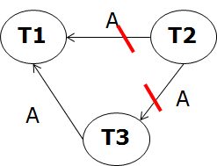
Problem To Solve
What is the Equivalent serial schedule for non-serial scheduleS1:R3(A), R2(A),W3(A), R1(A), W1(A)
T1
A
T2
Given: Three Transactions
T1 with operations Read(A), Write(A)
T2 with operations Read(A)
T3 with operations Read(A), Write(A)
Schedule S1: R3(A), R2(A),W3(A), R1(A), W1(A)
A
A
T3
T2
Consider first T2
Because indegree is
one

Slide 123
Problem To Solve
What is the Equivalent serial schedule for non-serial scheduleS1:R3(A), R2(A),W3(A), R1(A), W1(A)
T1
A
T2
Given: Three Transactions
T1 with operations Read(A), Write(A)
T2 with operations Read(A)
T3 with operations Read(A), Write(A)
Schedule S1: R3(A), R2(A),W3(A), R1(A), W1(A)
A
A
T3
T2
T2, T3
Consider first T2
Because indegree is
one
T2, T3, t1

Slide 124
Solution
What is the Equivalent serial schedule for non-serial schedule S1:R3(A), R2(A),W3(A), R1(A), W1(A)
T1
A
T2
Given: Three Transactions
T1 with operations Read(A), Write(A)
T2 with operations Read(A)
T3 with operations Read(A), Write(A)
Schedule S1: R3(A), R2(A),W3(A), R1(A), W1(A)
A
A
T3
T2
T2, T3
Consider first T2
Because indegree is
one
T2, T3, t1
Equivalent Serial Schedule is: T2, T3, T1
R2(A), R3(A),W3(A), R1(A), W1(A)

Slide 125
Problem to Solve
Which of the following schedules is (conflict) serializable? For each serializable schedule, determine the equivalent serial schedules.
(a) r1 (X); r3 (X); w1(X); r2(X); w3(X)
(b) r1 (X); r3 (X); w3(X); w1(X); r2(X)
(c) r3 (X); r2 (X); w3(X); r1(X); w1(X)
(d) r3 (X); r2 (X); r1(X); w3(X); w1(X)

Slide 126
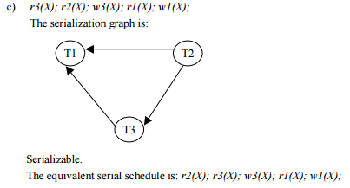
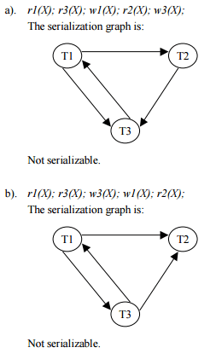

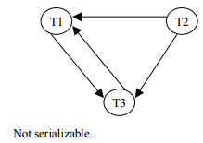
Solution

Slide 127
Problem to Solve
Consider the three transactions T1, T2, and T3, and the schedules S1 and S2 given below. Draw the serializibility (precedence) graphs for S1 and S2 and state whether each schedule is serializable or not. If a schedule is serializable, write down the equivalent serial schedule(s).
T1: r1(x); r1(z); w1(x)
T2: r2(z); r2(y); w2(z); w2(y)
T3: r3(x); r3(y); w3(y)
S1: r1(x); r2(z); r1(z); r3(x); r3(y); w1(x); w3(y); r2(y); w2(z); w2(y)
S2: r1(x); r2(z); r3(x); r1(z); r2(y); r3(y); w1(x); w2(z); w3(y); w2(y)

Slide 128
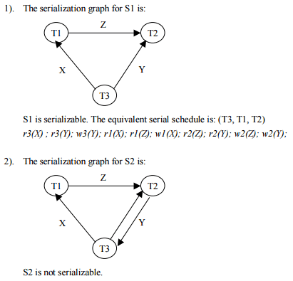
Solution

Slide 129
What you have learned until now in Unit4:Transactions
Serial Schedule
Serializable Schedule
Conflict Serializable Schedule (CS)
- Algorithm for testing CS and Converting to Serial Schedule

Slide 130
Characterizing Schedules based on Serializibility
Based on Serializability
Conflict Serializable Schedule
View Serializable Schedule

Slide 131
View Serializability Schedule
A Schedule is View Serializable if it is view equivalent to some serial schedule
What is View equivalence ?
In View Equivalence, respective transactions in the two schedules read and write the same data values
Same WR order: If in S1: wj(A) –> ri(A)
then in S2: wj(A)-> ri(A)
First Read: If in S1: ri(A) reads initial DB value,
then in S2: ri(A) also reads initial DB value
Last Write: If in S1: wi(A) does last write on A,
then in S2: wi(A) also does last write on A
Note: i,j are identifiers
of Transactions

Slide 132
View Serializability Schedule
A Schedule is View Serializable if it is view equivalent to some serial schedule
What is View equivalence ?
In View Equivalence, respective transactions in the two schedules read and write the same data values
Same WR order: If in S1: wj(A) –> ri(A)
then in S2: wj(A)-> ri(A)
First Read: If in S1: ri(A) reads initial DB value,
then in S2: ri(A) also reads initial DB value
Last Write: If in S1: wi(A) does last write on A,
then in S2: wi(A) also does last write on A
Note: i,j are identifiers
of Transactions
Note: The premise behind view equivalence:
– “The view”: the read operations are said to see the same view in both schedules.
– Rule: As long as each read operation of a transaction reads the result of the same
write operation in both schedules, the write operations of each transaction must
produce the same results.

Slide 133
View Equivalence Schedules
View Equivalence, respective transactions in the two schedules read and write the same data values
Initial Reads: If in S1: ri(A) reads initial DB value,
then in S2: ri(A) also reads initial DB value
Same WR order: If in S1: wj(A) –> ri(A)
then in S2: wj(A)-> ri(A)
Final Writes: If in S1: wi(A) does last write on A,
then in S2: wi(A) also does last write on A
Schedule S1
Schedule S2
T1 | T2 | T3
 | R(X)
 |  | R(X)
 |  | W(X)
R(X)
W(X)
T1 | T2 | T3
 |  | R(X)
 | R(X)
 |  | W(X)
R(X)
W(X)
Schedule S2 is view equivalent to serial schedule S1

Slide 134
View Equivalence Schedules
View Equivalence, respective transactions in the two schedules read and write the same data values
Initial Reads: If in S1: ri(A) reads initial DB value,
then in S2: ri(A) also reads initial DB value
Same WR order: If in S1: wj(A) –> ri(A)
then in S2: wj(A)-> ri(A)
Final Writes: If in S1: wi(A) does last write on A,
then in S2: wi(A) also does last write on A
Schedule S2 is view equivalent to serial schedule S1
T1 | T2 | T3
 | R(X)
 |  | R(X)
 |  | W(X)
R(X)
W(X)
T1 | T2 | T3
 |  | R(X)
 | R(X)
 |  | W(X)
R(X)
W(X)
Same Initial
Reads in S1 and S2
Schedule S1
Schedule S2

Slide 135
View Equivalence Schedules
View Equivalence, respective transactions in the two schedules read and write the same data values
Initial Reads: If in S1: ri(A) reads initial DB value,
then in S2: ri(A) also reads initial DB value
Same WR order: If in S1: wj(A) –> ri(A)
then in S2: wj(A)-> ri(A)
Final Writes: If in S1: wi(A) does last write on A,
then in S2: wi(A) also does last write on A
Schedule S2 is view equivalent to serial schedule S1
T1 | T2 | T3
 | R(X)
 |  | R(X)
 |  | W(X)
R(X)
W(X)
T1 | T2 | T3
 |  | R(X)
 | R(X)
 |  | W(X)
R(X)
W(X)
Same Write
Reads orders in
S1 and S2
Schedule S1
Schedule S2

Slide 136
View Equivalence Schedules
View Equivalence, respective transactions in the two schedules read and write the same data values
Initial Reads: If in S1: ri(A) reads initial DB value,
then in S2: ri(A) also reads initial DB value
Same WR order: If in S1: wj(A) –> ri(A)
then in S2: wj(A)-> ri(A)
Final Writes: If in S1: wi(A) does last write on A,
then in S2: wi(A) also does last write on A
Schedule S2 is view equivalent to serial schedule S1
T1 | T2 | T3
 | R(X)
 |  | R(X)
 |  | W(X)
R(X)
W(X)
T1 | T2 | T3
 |  | R(X)
 | R(X)
 |  | W(X)
R(X)
W(X)
Same Final
Writes in
S1 and S2
Schedule S1
Schedule S2

Slide 137
View Equivalence
View Serializability Summary:
i. Same Transaction Reads Data First.
ii. Same WR Order of actions.
iii. Same Transaction Writes Data Last.

Slide 138
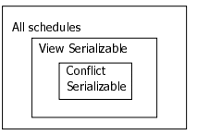
Summarizing Serializability Schedules
Venn diagram
Note:
Any Conflict serializable schedules is also
View serializable schedule but not vice-versa
Note:
There is an algorithm to test whether a schedule S is view serial schedule.
However, the problem of testing view serializability has been shown to be
NP-hard, meaning that finding an efficient polynomial time algorithm for
this problem is highly unlikely.

Slide 139
Characterizing Schedules
Characterizing different schedules based on the following two properties:
A. Based on Serializability
- We shall ignore Commits and Aborts for this section
- Characterize which schedules are correct when concurrent transactions are executing.
Conflict Serializable Schedule
View Serializable Schedule
B. Based on Recoverability
- Commits and Aborts become important for this section
- Characterize which schedules can be recovered and how easily.
Recoverable Schedule
Cascadeless schedule
Strict Schedules

Slide 140
Characterizing Schedules based on Recoverability
Based on Recoverability
Characterize which schedules can be recovered and how easily.
Recoverable Schedule
Cascadeless or Avoid Cascading Rollback schedule
Strict Schedules
Notes:
Recoverable Schedule
Cascading Rollback or Cascading Abort
Cascadeless or Avoid Cascading Rollback schedule
Strict Schedules

Slide 141
Recoverable Schedule
Recoverability is a situation where we can recover database system to a consistent way after failure.
Recoverable schedule: A schedule S is recoverable if no transaction T in S commits until all transactions T’, that have written an item that T reads, have committed.

Slide 142
Recoverable Schedule
Recoverability is a situation where we can recover database system to a consistent way after failure.
Recoverable schedule: A schedule S is recoverable if no transaction T in S commits until all transactions T’, that have written an item that T reads, have committed.
Recoverable Schedule
T1 | T2
R(X)
X=X+10
W(X)
Commit
 | R(X)
 | X=X-5
 | W(X)
 | Commit
Note: A committed transaction
should never be rolled back

Slide 143
Recoverable Schedule
Recoverability is a situation where we can recover database system to a consistent way after failure.
Recoverable schedule: A schedule S is recoverable if no transaction T in S commits until all transactions T’, that have written an item that T reads, have committed.
Non-Recoverable Schedule
Recoverable Schedule
T1 | T2
R(X)
X=X+10
W(X)
 | R(X)
 | X=X-5
 | W(X)
 | Commit
T1 | T2
R(X)
X=X+10
W(X)
Commit
 | R(X)
 | X=X-5
 | W(X)
 | Commit
Note: A committed transaction
should never be rolled back

Slide 144
Recoverable Schedule
Recoverability is a situation where we can recover database system to a consistent way after failure.
Recoverable schedule: A schedule S is recoverable if no transaction T in S commits until all transactions T’, that have written an item that T reads, have committed.
Question: Following is Recoverable Schedule ? Yes / No
T1 | T2
R(X)
W(X)
 | R(X)
W(X)
 | W(X)
 | Commit
Abort

Slide 145
Recoverable Schedule
Recoverability is a situation where we can recover database system to a consistent way after failure.
Recoverable schedule: A schedule S is recoverable if no transaction T in S commits until all transactions T’, that have written an item that T reads, have committed.
Question: Following is Recoverable Schedule ? Yes / No
T1 | T2
R(X)
W(X)
 | R(X)
W(X)
 | W(X)
 | Commit
Abort
Dirty Read
Answer: NO
Why NOT recoverable?
•Because T2 made a dirty read and committed before T1

Slide 146
Recoverable Schedule
Recoverability is a situation where we can recover database system to a consistent way after failure.
Recoverable schedule: A schedule S is recoverable if no transaction T in S commits until all transactions T’, that have written an item that T reads, have committed.
Question: Following is Recoverable Schedule ? Yes / NoRecoverable Schedule
T1 | T2
R(X)
W(X)
 | R(X)
W(X)
 | W(X)
 | Commit
Abort
Answer: NO
Why it not a recoverable schedule?
•Because T2 made a dirty read and committed before T1
But why is the schedule Nonrecoverable ?
•Because when the recovery manager rolls back
(step a) T1 then A gets its initial value.
•But T2 has already utilized this wrong value
and committed something to the DB
•The DB is consequently in an inconsistent state!
Dirty Read
Step a:
Rollback

Slide 147

Problem to Solve on Recoverable Schedules
Check whether the following schedule is recoverable schedule
Recoverable schedule: A schedule is recoverable if the following condition is satisfied:
Tj should commit after Ti if Tj has read any data item written by Ti.
……..Wi(x)……….Rj(x)…………Ci………..Cj -> This schedule is recoverable
……..Wi(x)……….Rj(x)…………Cj………..Ci -> This schedule is non-recoverable

Slide 148
Problem to Solve on Recoverable Schedules
Check whether the following schedule is recoverable schedule
Answer: Non-recoverable
Transaction T2 reads the data item R2(y) written by T3 w3(y)
Schedule is non-recoverable because transaction T2 commits C2 before T3 commits C3.
Recoverable schedule: A schedule is recoverable if the following condition is satisfied:
Tj should commit after Ti if Tj has read any data item written by Ti.
……..Wi(x)……….Rj(x)…………Ci………..Cj -> This schedule is recoverable
……..Wi(x)……….Rj(x)…………Cj………..Ci -> This schedule is non-recoverable

Slide 149
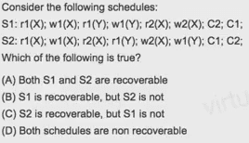
Problem to Solve
Recoverable schedule: A schedule is recoverable if the following condition is satisfied:
Tj should commit after Ti if Tj has read any data item written by Ti.
……..Wi(x)……….Rj(x)…………Ci………..Cj -> This schedule is recoverable
……..Wi(x)……….Rj(x)…………Cj………..Ci -> This schedule is non-recoverable
Notes:
https://www.youtube.com/watch?v=pshqwLNoMuc

Slide 150
Problem to Solve
S1
S2
T1 | T2
R1(X)
W1(X)
R1(Y)
W1(Y)
 | R2(X)
 | W2(X)
 | C2
C1
T1 | T2
R1(X)
W1(X)
 | R2(X)
R1(Y)
 | W2(X)
W1(Y)
C1
 | C2
S1 Non-Recoverable
S2 Recoverable
Notes:
https://www.youtube.com/watch?v=pshqwLNoMuc

Slide 151
Problem to Solve on Recoverable Schedules
Check whether the following schedule is recoverable schedule
Recoverable schedule: A schedule is recoverable if the following condition is satisfied:
Tj should commit after Ti if Tj has read any data item written by Ti.
……..Wi(x)……….Rj(x)…………Ci………..Cj -> This schedule is recoverable
……..Wi(x)……….Rj(x)…………Cj………..Ci -> This schedule is non-recoverable

Slide 152
Problem to Solve on Recoverable Schedules
Check whether the following schedule is recoverable schedule
Answer: Non-recoverable
Recoverable schedule: A schedule is recoverable if the following condition is satisfied:
Tj should commit after Ti if Tj has read any data item written by Ti.
……..Wi(x)……….Rj(x)…………Ci………..Cj -> This schedule is recoverable
……..Wi(x)……….Rj(x)…………Cj………..Ci -> This schedule is non-recoverable

Slide 153
Characterizing Schedules based on Recoverability
Based on Recoverability
Recoverable Schedule
Cascadeless or Avoid Cascading Rollback schedule
Strict Schedules
Notes:
Recoverable Schedule
Cascading Rollback or Cascading Abort
Cascadeless or Avoid Cascading Rollback schedule
Strict Schedules

Slide 154
Cascading Abort
What is Cascading? When effect of one thing is migrated to other and followed by another.
Cascading Abort or
Cascading Rollback
T1 | T2 | T3
R(X)
W(X)
 | R(X)
 | W(X)
 |  | R(X)
 |  | W(X)

Slide 155
Cascading Abort
What is Cascading? When effect of one thing is migrated to other and followed by another.
Cascading Abort or
Cascading Rollback
T1 | T2 | T3
R(X)
W(X)
 | R(X)
 | W(X)
 |  | R(X)
 |  | W(X)
Abort1
 | Abort2
 |  | Abort3
If system fails
here then
Transaction
T1 aborts similarly
T2 aborts and
T3 aborts
Cascading Rollback

Slide 156
Cascadeless Schedule
Cascadeless Schedule: Schedule that Avoids Cascading Rollbacks
A schedule is said to be cascadeless schedule or avoid cascading rollback, if every transaction in the schedule reads only items that were written by committed transactions
Cascadeless Schedule
T1 | T2 | T3
R(X)
W(X)
Commit
 | R(X)
 | W(X)
 | Commit
 |  | R(X)
 |  | W(X)
 |  | Commit
Notes:
One where a rollback does not cascade to other transactions
Why is this necessary? Rollbacks are Costly!
–How can we achieve it? Every transaction reads only the items that are written by committed transactions.

Slide 157
Problem to Solve on Cascadeless Schedules
Check whether the following schedule is cascadeless schedule
Cascadeless: A schedule is said to be cascadeless, if every transaction in the
schedule reads only items that were written by commited (or aborted) transactions.
Cascadeless schedule: A schedule is cascadeless if the following condition is satisfied:
- Tj reads X only after Ti has written to X and committed (aborted or terminated).
…….Wi(x)…………Ci(x)/Ai(x)……….Rj(x) -> This schedule is Cascadeless

Slide 158
Problem to Solve on Cascadeless Schedules
Check whether the following schedule is cascadeless schedule
Answer: Yes, Cascadeless
T2 reads x after the last transaction that writes x i.e. T1 has committed.
Hence S is Cascadeless
Cascadeless: A schedule is said to be cascadeless, if every transaction in the
schedule reads only items that were written by commited (or aborted) transactions.
Cascadeless schedule: A schedule is cascadeless if the following condition is satisfied:
- Tj reads X only after Ti has written to X and committed (aborted or terminated).
…….Wi(x)…………Ci(x)/Ai(x)……….Rj(x) -> This schedule is Cascadeless

Slide 159
Characterizing Schedules based on Recoverability
Based on Recoverability
Recoverable Schedule
Cascadeless or Avoid Cascading Rollback schedule
Strict Schedules
Notes:
Recoverable Schedule
Cascading Rollback or Cascading Abort
Cascadeless or Avoid Cascading Rollback schedule
Strict Schedules

Slide 160
Strict Schedule
A restrictive type of schedule, called strict schedule, in which transaction neither read nor write an item X until the last transaction that wrote X has committed (terminated or aborted).
Formally, if it satisfies the following conditions:
–Tj reads a data item X after Ti has written to X and Ti is committed (aborted or terminated)
–Tj writes a data item X after Ti has written to X and Ti is committed (aborted or terminated)
Strict Schedule
T1 | T2
R(X)
W(X)
Commit1
 | R(X)
 | W(X)

Slide 161
Problem to Solve on Strict Schedules
Check whether the following schedule is strict schedule
Strict schedule: A schedule is strict if it satisfies the following conditions:
Tj reads a data item X after Ti has written to X and Ti is committed (aborted or
terminated)
2. Tj writes a data item X after Ti has written to X and Ti is committed (aborted or
terminated)
……..Wi(x)…………Ci(x)………………Rj(x)/Wj(x) -> This schedule is Strict
……..Wi(x)…………Rj(x)/Wj(x )…..Ci(x) -> This schedule is not strict

Slide 162
Problem to Solve on Strict Schedules
Check whether the following schedule is strict schedule
Answer: Strict
Strict schedule: A schedule is strict if it satisfies the following conditions:
Tj reads a data item X after Ti has written to X and Ti is committed (aborted or
terminated)
2. Tj writes a data item X after Ti has written to X and Ti is committed (aborted or
terminated)
……..Wi(x)…………Ci(x)………………Rj(x)/Wj(x) -> This schedule is Strict
……..Wi(x)…………Rj(x)/Wj(x )…..Ci(x) -> This schedule is not strict

Slide 163
Problem to Solve on Strict Schedules
Check whether the following schedule is strict schedule
Strict schedule: A schedule is strict if it satisfies the following conditions:
Tj reads a data item X after Ti has written to X and Ti is committed (aborted or
terminated)
2. Tj writes a data item X after Ti has written to X and Ti is committed (aborted or
terminated)
……..Wi(x)…………Ci(x)………………Rj(x)/Wj(x) -> This schedule is Strict
……..Wi(x)…………Rj(x)/Wj(x )…..Ci(x) -> This schedule is not strict

Slide 164
Problem to Solve on Strict Schedules
Check whether the following schedule is strict schedule
Answer: Not, Strict
Strict schedule: A schedule is strict if it satisfies the following conditions:
Tj reads a data item X after Ti has written to X and Ti is committed (aborted or
terminated)
2. Tj writes a data item X after Ti has written to X and Ti is committed (aborted or
terminated)
……..Wi(x)…………Ci(x)………………Rj(x)/Wj(x) -> This schedule is Strict
……..Wi(x)…………Rj(x)/Wj(x )…..Ci(x) -> This schedule is not strict

Slide 165

Problem to Solve on Strict Schedules
Check whether the following schedule is strict schedule
Strict schedule: A schedule is strict if it satisfies the following conditions:
Tj reads a data item X after Ti has written to X and Ti is committed (aborted or
terminated)
2. Tj writes a data item X after Ti has written to X and Ti is committed (aborted or
terminated)
……..Wi(x)…………Ci(x)………………Rj(x)/Wj(x) -> This schedule is Strict
……..Wi(x)…………Rj(x)/Wj(x )…..Ci(x) -> This schedule is not strict

Slide 166
Problem to Solve on Strict Schedules
Check whether the following schedule is strict schedule
Answer: Yes, Strict
Strict schedule: A schedule is strict if it satisfies the following conditions:
Tj reads a data item X after Ti has written to X and Ti is committed (aborted or
terminated)
2. Tj writes a data item X after Ti has written to X and Ti is committed (aborted or
terminated)
……..Wi(x)…………Ci(x)………………Rj(x)/Wj(x) -> This schedule is Strict
……..Wi(x)…………Rj(x)/Wj(x )…..Ci(x) -> This schedule is not strict

Slide 167
Summary of Schedules based on Recoverability
All Schedules
Recoverable Schedule
Avoids cascading rollback
Cascadeless schedule
Strict Schedule
Note:
- Strict schedules are Cascadeless and Recoverable schedule
- Cascadeless schedules are Recoverable schedule

Slide 168
Transactions and Schedule
Transactions and Schedules
– Serial Schedule … one after the other…
– Complete Schedule … with Commit, Abort
Serializability
– “Correctness Measure” of some Schedule
– Why is it useful? It answers the question: “Will an interleaved schedule execute correctly
– i.e., a Serializable schedule will execute as correctly as serial schedule … but in an interleaved manner!
Recoverability
– “Recoverability Measure” of some Schedule.
– Why is it useful? It answers the question: “Do we need to rollback a some (or all) transactions in an interleaved schedule after some Failure (e.g., ABORT)”
– i.e., in a Recoverable schedule no transaction needs to be rolled back once committed!

Slide 169
Properties of Transactions
ACID Properties
1. Atomicity
2. Consistency preservation
3. Isolation
4. Durability or permanency

Slide 170
Properties of Transactions
1.Atomicity
Either all operations of a transaction occurs or none
Their should not be the case where half of the operations
of transaction has been executed and other remaining half of the operations has not been executed.
Example of Transaction:
Increasing salary of an employee by 10%.
The three operations of this transactions are:
read(salary),salary=salary+salary*0.10,write(salary)
All this three operations should be executed for the transaction to be successful

Slide 171
Properties of Transactions
2. Consistency preservation (or Correctness)
A transaction should lead database from one consistent state to another consistent state.
Example: Say in a database table if both Date of Birth (DOB) and Age values are stored.
If any transaction changes DOB then appropriately the change in age value should reflected in database table. When DOB is changed but Age value has not been changed then table data will not be in consistent state.

Slide 172
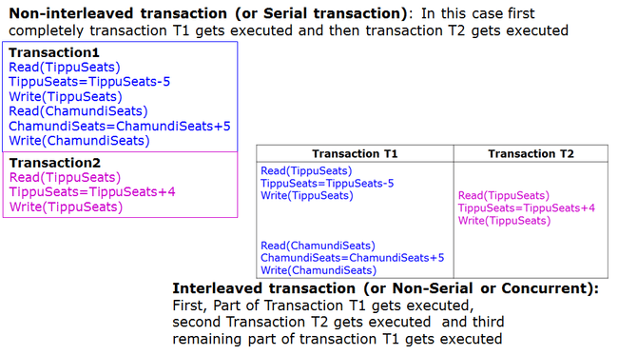
Properties of Transactions
3. Isolation
Ensures that concurrent execution results in a system state that would be obtained if transaction would be executed serially.

Slide 173
Properties of Transactions
4. Durability or permanency
Changes should be permanent. The changes must NOT be lost due to some database failure.

Slide 174
Summarizing Properties of Transactions
ACID Properties
1. Atomicity
2. Consistency preservation
3. Isolation
4. Durability or permanency

Slide 175
Transaction
A transaction is an atomic unit of work that is either completed in its entirety or not done at all.
For recovery purposes, the system needs to keep track of when the transaction starts, terminates, and commits or aborts.
Transaction states:
Active state
Partially committed state
Committed state
Failed state
Terminated State

Slide 176
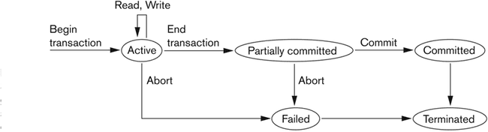
State transition diagram illustrating the states for transaction execution
Active, the initial state; the transaction stays in this state while it is executing
Partially committed, after the final statement has been executed.
Failed, after the discovery that normal execution can no longer proceed.
Aborted, after the transaction has been rolled back and the database restored to its state prior to the start of the transaction. Two options after it has been aborted:
restart the transaction – only if no internal logical error
kill the transaction
Committed, after successful completion
Notes:
When the transaction ends, it moves to partially committed state. At this point, some recovery protocols need to ensure that a system failure will not result in an inability to record changes of the transaction permanently. Once this check is successful, the transaction is said to have reached its commit point and enters the committed state.

Slide 177
Next what you are going learn is………
Concurrency Control Protocols
- To ensure when to give access to data item when transactions are getting executed concurrently or in interleaved way

Slide 178
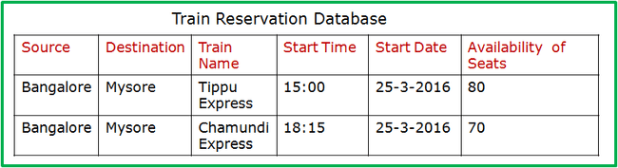
Why we need Concurrency Control Protocols ?
Consider an example of Train Reservation System
User1
Train Ticket Booking Software
User2
User1: Wants to reserve 5 seats on
Tippu express
User2: Wants to reserve 4 seats on
Tippu express
Transaction T1
Transaction T2
Read(TippuSeats)
TippuSeats=TippuSeats-5
Write(TippuSeats)
Read(TippuSeats)
TippuSeats=TippuSeats-4
Write(TippuSeats)

Slide 179
Why we need Concurrency Control Protocols ?
Case 1: When the User1 Logins at 4:00pm to booking system and
User 2 Logins at 4:03pm to booking system
Time | T1 | T2
4:00pm | Read(TippuSeats)
4:01pm | TippuSeats=TippuSeats-5
4:02pm | Write(TippuSeats)
4:03pm |  | Read(TippuSeats)
4:04pm |  | TippuSeats=TippuSeats-4
4:05pm |  | Write(TippuSeats)
Database
Tippu Seats
80
Tippu Seats
80 71
Initial Value
Final Value

Slide 180
Why we need Concurrency Control Protocols ?
Case 2: When the User1 Logins at 4:03pm to booking system and
User 2 Logins at 4:00pm to booking system
Time | T1 | T2
4:00pm |  | Read(TippuSeats)
4:01pm |  | TippuSeats=TippuSeats-4
4:02pm |  | Write(TippuSeats)
4:03pm | Read(TippuSeats)
4:04pm | TippuSeats=TippuSeats-5
4:05pm | Write(TippuSeats)
Database
Tippu Seats
80
Tippu Seats
80 71
Initial Value
Final Value

Slide 181
Why we need Concurrency Control Protocols ?
Case 3: When the User1 Logins at 4:00pm to booking system and
User 2 Logins at 4:01pm to booking system
Time | T1 | T2
4:00pm | Read(TippuSeats)
4:01pm | TippuSeats=TippuSeats-5 | Read(TippuSeats)
4:02pm | Write(TippuSeats) | TippuSeats=TippuSeats-4
4:03pm |  | Write(TippuSeats)
4:04pm
4:05pm
Question:
What will be the final value Of TippuSeats when above Transactions are executed ?
Database
Tippu Seats
80
Initial Value

Slide 182
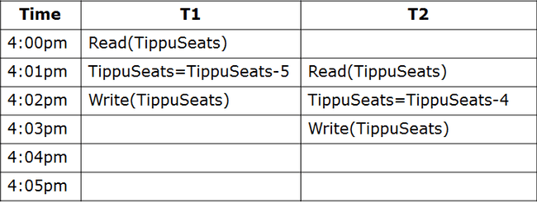
Why we need Concurrency Control Protocols ?
Case 3: When the User1 Logins at 4:00pm to booking system and
User 2 Logins at 4:01pm to booking system
Database is in
Inconsistent state
WRONG value 76
Updaed for Tippu Seats
Database
Tippu Seats
80
Tippu Seats
80 76
Initial Value
Final Value

Slide 183
Why we need Concurrency Control Protocols ?
Case 3: When the User1 Logins at 4:00pm to booking system and
User 2 Logins at 4:01pm to booking system
Database is in
Inconsistent state
WRONG value 76
Updaed for Tippu Seats
Database
Tippu Seats
80
Tippu Seats
80 76
Initial Value
Final Value
To avoid this type of
Problems Concurrency
Control Protocols
will be used

Slide 184
Why we need Concurrency Control Protocols ?
When two or more users or transactions wants to access the same data item then concurrency control protocols should be followed to leave database to a consistent state after completion of executing transactions.
One type Concurrency protocols are LOCK based protocols
Under LOCK based protocol any transaction that needs to access the data item should first obtain the LOCK on the data item

Slide 185
Concurrency Control Protocol: LOCK based
For the following transactions schedule we will see by using
LOCK based protocol, how to obtain correct value i.e., leaving the
Database system in a consistent state after execution of transactions
Database
Tippu Seats
80
LOCK
0
Initial Value

Slide 186
Concurrency Control Protocol: LOCK based
Time | T1 | T2
4:00pm | LOCK(TippuSeats), Read(TippuSeats)
4:01pm
4:02pm
4:03pm
4:04pm
4:05pm
Database
Tippu Seats
80
LOCK
01
When Transaction T1 executes,
LOCK(TippuSeats), LOCK variable value of
TippuSeats will be changed from zero to one

Slide 187
Concurrency Control Protocol: LOCK based
Time | T1 | T2
4:00pm | LOCK(TippuSeats), Read(TippuSeats)
4:01pm | TippuSeats=TippuSeats-5 | T2 will WAIT because it cannot obtain LOCK on data item TippuSeats
4:02pm
4:03pm
4:04pm
4:05pm
Database
Tippu Seats
80
LOCK
0 1
When transaction T2 comes at 4:01pm,
Then T2 will check for LOCK variable value
Of TippuSeats it is ONE so T2 WAITS

Slide 188
Concurrency Control Protocol: LOCK based
Time | T1 | T2
4:00pm | LOCK(TippuSeats), Read(TippuSeats)
4:01pm | TippuSeats=TippuSeats-5 | T2 will WAIT because it cannot obtain LOCK on data item TippuSeats
4:02pm | Write(TippuSeats), UNLOCK(TippuSeats) | WAIT
4:03pm
4:04pm
4:05pm
When transaction T1 executes
UNLOCK(TippuSeats), LOCK value of
TippuSeats will be changed from ONE
to ZERO
Database
Tippu Seats
80 75
LOCK
0 1 0

Slide 189
Concurrency Control Protocol: LOCK based
Time | T1 | T2
4:00pm | LOCK(TippuSeats), Read(TippuSeats)
4:01pm | TippuSeats=TippuSeats-5 | T2 will WAIT because it cannot obtain LOCK on data item TippuSeats
4:02pm | Write(TippuSeats), UNLOCK(TippuSeats) | WAIT
4:03pm |  | LOCK(TippuSeats), Read(TippuSeats)
4:04pm
4:05pm
Database
Tippu Seats
80 75
LOCK
0 1 0 1
When transaction T2 executes
LOCK(TippuSeats), LOCK value of
TippuSeats will be changed from ZERO
to ONE

Slide 190
Concurrency Control Protocol: LOCK based
Time | T1 | T2
4:00pm | LOCK(TippuSeats), Read(TippuSeats)
4:01pm | TippuSeats=TippuSeats-5 | T2 will WAIT because it cannot obtain LOCK on data item TippuSeats
4:02pm | Write(TippuSeats), UNLOCK(TippuSeats) | WAIT
4:03pm |  | LOCK(TippuSeats), Read(TippuSeats)
4:04pm |  | TippuSeats=TippuSeats-4
4:05pm |  | Write(TippuSeats), UNLOCK(TippuSeats)
Database
Tippu Seats
80 75 71
LOCK
0 1 0 1 0
Now final value of TippuSeats
is 71, which is CORRECT

Slide 191
Lock-based Protocols
A transaction must get a lock before operating on the data. LOCKS are used to ensure concurrency.
Two types of locks:
Shared (S) locks (also called read locks)
Obtained if transactions want to only read an item
Exclusive (X) locks (also called write locks)
Obtained for updating a data item

Slide 192
Lock-based Protocols
A transaction must get a lock before operating on the data. LOCKS are used to ensure concurrency.
Two types of locks:
Shared (S) locks (also called read locks)
Obtained if transactions want to only read an item
Exclusive (X) locks (also called write locks)
Obtained for updating a data item
 |  | User 1, HOLDER of the LOCK on data item X
 |  | Shared or Read Lock | Write or Exclusive Lock
User2, REQUESTOR of LOCK for data item X | Shared or Read Lock
 | Write or Exclusive Lock

Slide 193
Lock-based Protocols
A transaction must get a lock before operating on the data
Two types of locks:
Shared (S) locks (also called read locks)
Obtained if we want to only read an item
Exclusive (X) locks (also called write locks)
Obtained for updating a data item
 |  | User 1, HOLDER of the LOCK on data item X
 |  | Shared or Read Lock | Write or Exclusive Lock
User2, REQUESTOR of LOCK for data item X | Shared or Read Lock | YES: USER 2 will granted with Read lock
 | Write or Exclusive Lock

Slide 194
Lock-based Protocols
A transaction must get a lock before operating on the data
Two types of locks:
Shared (S) locks (also called read locks)
Obtained if transactions want to only read an item
Exclusive (X) locks (also called write locks)
Obtained for updating a data item
 |  | User 1, HOLDER of the LOCK on data item X
 |  | Shared or Read Lock | Write or Exclusive Lock
User2, REQUESTOR of LOCK for data item X | Shared or Read Lock | YES: USER 2 will granted with Read lock | NO: USER 2 will not be granted with Read lock
 | Write or Exclusive Lock

Slide 195
Lock-based Protocols
A transaction must get a lock before operating on the data
Two types of locks:
Shared (S) locks (also called read locks)
Obtained if transactions want to only read an item
Exclusive (X) locks (also called write locks)
Obtained for updating a data item
 |  | User 1, HOLDER of the LOCK on data item X
 |  | Shared or Read Lock | Write or Exclusive Lock
User2, REQUESTOR of LOCK for data item X | Shared or Read Lock | YES: USER 2 will granted with Read lock | NO: USER 2 will not be granted with Read lock
 | Write or Exclusive Lock | ?? | ??

Slide 196
Lock-based Protocols
A transaction must get a lock before operating on the data
Two types of locks:
Shared (S) locks (also called read locks)
Obtained if transactions want to only read an item
Exclusive (X) locks (also called write locks)
Obtained for updating a data item
 |  | User 1, HOLDER of the LOCK on data item X
 |  | Shared or Read Lock | Write or Exclusive Lock
User2, REQUESTOR of LOCK for data item X | Shared or Read Lock | YES: USER 2 will granted with Read lock | NO: USER 2 will not be granted with Read lock
 | Write or Exclusive Lock | NO: USER 2 will not be granted with Write lock | NO: USER 2 will not be granted with Write lock

Slide 197
Lock instructions
New LOCK instructions
- Lock-S: shared (or read) lock request
- Lock-X: exclusive (or write) lock request
- Unlock: release previously held lock
Example schedule:
T1
T2
read(B)
B =B-50
write(B)
read(A)
A =A + 50
write(A)
read(A)
read(B)
display(A+B)

Slide 198
Lock instructions
New LOCK instructions
- Lock-S: shared (or read) lock request
- Lock-X: exclusive (or write) lock request
- Unlock: release previously held lock
Example schedule:
T1
T2
Lock-X(B)
read(B)
B = B-50
write(B)
Unlock(B)
Lock-X(A)
read(A)
A =A + 50
write(A)
Unlock(A)
Lock-S(A)
read(A)
Unlock(A)
Lock-S(B)
read(B)
Unlock(B)
display(A+B)

Slide 199
Lock-based Protocols
Lock requests are made to the concurrency control manager
It decides whether to grant a lock request
T1 asks for a lock on data item A, and T2 currently has a lock on it ?
Depends
If compatible, grant the lock, otherwise T1 waits in a queue.
T2 lock type | T1 lock type | Should allow ?
Shared | Shared | YES
Shared | Exclusive | NO
Exclusive | - | NO

Slide 200
Lock-based Protocols
How do we actually use this to guarantee serializability/recoverability ?
Not enough just to take locks when you need to read/write something
T1
Lock-X(B)
read(B)
B ←B-50
write(B)
Unlock(B)
Lock-X(A)
read(A)
A ←A + 50
write(A)
Unlock(A)
T2
Lock-X(A), Lock-X(B)
A = A-50
B = B+50
Unlock(A), Unlock(B)

Slide 201
Two-Phase Locking Protocol (2PL)
A transaction is said to follow two phase locking protocol if all
locking operations (read-lock or shared lock, write-lock or
Exclusive- lock) precede the first Unlock operation in the
transaction. Such transaction can be divided into two phases
Phase 1: Growing (or Lock Acquiring) phase
Transaction may obtain locks
But may not release them
Phase 2: Shrinking (or Lock Releasing) phase
Transaction may only release locks

Slide 202
Two-Phase Locking Protocol (2PL)
Phase 1: Growing (or Lock Acquiring) phase
Transaction may obtain locks
But may not release them
Phase 2: Shrinking (or Lock Releasing) phase
Transaction may only release locks
T1: Not following 2PL
Lock-X(B)
read(B)
B ←B-50
write(B)
Unlock(B)
Lock-X(A)
read(A)
A ←A + 50
write(A)
Unlock(A)

Slide 203
Two-Phase Locking Protocol (2PL)
Phase 1: Growing (or Lock Acquiring) phase
Transaction may obtain locks
But may not release them
Phase 2: Shrinking (or Lock Releasing) phase
Transaction may only release locks
T1: Not following 2PL
Lock-X(B)
read(B)
B ←B-50
write(B)
Unlock(B)
Lock-X(A)
read(A)
A ←A + 50
write(A)
Unlock(A)

Slide 204
Two-Phase Locking Protocol (2PL)
Phase 1: Growing (or Lock Acquiring) phase
Transaction may obtain locks
But may not release them
Phase 2: Shrinking (or Lock Releasing) phase
Transaction may only release locks
T1: Follows 2PL
T1: Not following 2PL
Lock-X(B)
read(B)
B = B - 50
write(B)
Lock-X(A)
read(A)
A = A - 50
write(A)
unlock(B)
unlock(A)
Lock-X(B)
read(B)
B = B-50
write(B)
Unlock(B)
Lock-X(A)
read(A)
A =A + 50
write(A)
Unlock(A)
Growing phase
Shrinking phase

Slide 205
Variations of 2PL
1. Basic 2PL
Two Phase: Growing and Shrinking Phase
2. Conservative (or static) 2PL
Conservative 2PL requires a transaction to lock all the items it accesses before the transaction begins execution by pre declaring its write set and read set.
If any of the pre declared items needed cannot be locked, the transaction does not lock any item; instead it waits until all the items are available for locking
3. Strict 2PL
A transaction T does not release any of its exclusive (write) locks until after it commits or aborts.
Hence no other transaction can read or write an item that is written by T unless T has committed.
4. Rigorous 2PL
A transaction T does not release any of its locks (exclusive or shared) until after it commits or aborts and so it is easier to implement than strict 2PL.

Slide 206
Database Recovery Systems
Database Recovery Systems looks to achieve
Transaction Atomicity
Transaction Durability

Slide 207
Why recovery is Needed ?
To avoid following failures (or What causes a Transaction to fail)
1. A computer failure (system crash):A hardware or software error occurs in the computer system during transaction execution. If the hardware crashes, the contents of the computer’s internal memory may be lost.
2. A transaction or system error: Some operation in the transaction may cause it to fail, such as integer overflow or division by zero. Transaction failure may also occur because of erroneous parameter values or because of a logical programming error. In addition, the user may interrupt the transaction during its execution.
3. Local errors or exception conditions detected by the transaction: Certain conditions necessitate cancellation of the transaction. For example, data for the transaction may not be found. A condition, such as insufficient account balance in a banking database, may cause a transaction, such as a fund withdrawal from that account, to be canceled. A programmed abort in the transaction causes it to fail.
4. Concurrency control enforcement: The concurrency control method may decide to abort the transaction, to be restarted later, because it violates serializability or because several transactions are in a state of deadlock.
5. Disk failure: Some disk blocks may lose their data because of a read or write malfunction or because of a disk read/write head crash. This may happen during a read or a write operation of the transaction.
6. Physical problems and catastrophes: This refers to an endless list of problems that includes power or air-conditioning failure, fire, theft, sabotage, overwriting disks by mistake.

Slide 208
Failure Classification
Transaction failure :
Logical errors: transaction cannot complete due to some internal error condition
System errors: the database system must terminate an active transaction due to an error condition (e.g., deadlock)
System crash: a power failure or other hardware or software failure causes the system to crash.
Fail-stop assumption: non-volatile storage contents are assumed to not be corrupted by system crash
Database systems have numerous integrity checks to prevent corruption of disk data
Disk failure: a head crash or similar disk failure destroys all or part of disk storage
Destruction is assumed to be detectable: disk drives use checksums to detect failures

Slide 209
Recovery Algorithms
Recovery algorithms are techniques to ensure database consistency and transaction atomicity and durability despite failures
Recovery algorithms have two parts
1. Actions taken during normal transaction processing to ensure enough information exists to recover from failures
2. Actions taken after a failure to recover the database contents to a state that ensures atomicity, consistency and durability

Slide 210
Example: Database Transaction
Transferring Rs.100/- from account A to account B
ACCOUNTS
Account | Balance
A | 150
B | 100

Slide 211
Example: Database Transaction
Transferring Rs.100/- from account A to account B
Transaction T1
Read(A)
A=A-100
Write(A)
Read(B)
B=B+100
Write(B)
ACCOUNTS
Account | Balance
A | 150
B | 100

Slide 212
Example: Database Transaction
Transferring Rs.100/- from account A to account B
Transaction T1
Read(A)
A=A-100
Write(A)
Read(B)
B=B+100
Write(B)
ACCOUNTS
Account | Balance
A | 150 50
B | 100 200
Sate of Database, After
completely executing
all operations of
Transaction T1

Slide 213
Example: Database Transaction
Transferring Rs.100/- from account A to account B
Transaction T1
Read(A)
A=A-100
Write(A)
Read(B)
B=B+100
Write(B)
ACCOUNTS
Account | Balance
A | 150 50
B | 100
System
Crash
Sate of Database, until
The system crash.
Now database is inconsistent

Slide 214
Database Recovery Mechanisms
Recovery Categories
Shadowing (or Copying)
Database
Using LOG Entries
Based on
Deferred Update
Based on
Immediate Update

Slide 215
Recovery using Shadowing
Transferring Rs.100/- from account A to account B
T1
Begin
Transaction T1
Read(A)
A=A-100
Write(A)
Read(B)
B=B+100
Write(B)
ACCOUNTS
Account | Balance
A | 150
B | 100
Copy of ACCOUNTS
Shadow
Account | Balance
A | 150
B | 100

Slide 216
Recovery using Shadowing
Transferring Rs.100/- from account A to account B
T1
Begin
Transaction T1
Read(A)
A=A-100
Write(A)
Read(B)
B=B+100
Write(B)
ACCOUNTS
System
Crash
Account | Balance
A | 150 50
B | 100
Question:
Now, when system crash
Occurs how the database
Can be restored back to original
Data values
Copy of ACCOUNTS
Account | Balance
A | 150
B | 100

Slide 217
Recovery using Shadowing
Transferring Rs.100/- from account A to account B
T1
Begin
Transaction T1
Read(A)
A=A-100
Write(A)
Read(B)
B=B+100
Write(B)
ACCOUNTS
System
Crash
Account | Balance
A | 150 50 150
B | 100
Shadow
Of
Accounts
Table
Copy of ACCOUNTS
Account | Balance
A | 150
B | 100
When System
crash Occurs
copy from
Shadow

Slide 218
Recovery using Log Entries
Transferring Rs.100/- from account A to account B
Transaction T1
Read(A)
A=A-100
Write(A)
Read(B)
B=B+100
Write(B)
Commit
ACCOUNTS
Account | Balance
A | 150
B | 100
LOG of T1
[Start, T1]
[Read, T1, A]
Log
Entries
Of T1

Slide 219
Recovery using Log Entries
Transferring Rs.100/- from account A to account B
Transaction T1
Read(A)
A=A-100
Write(A)
Read(B)
B=B+100
Write(B)
Commit
ACCOUNTS
Account | Balance
A | 150
B | 100
LOG of T1
[Start, T1]
[Read, T1, A]
[Write,T1, A, 150, 50]
Log
Entries
Of T1

Slide 220
Recovery using Log Entries
Transferring Rs.100/- from account A to account B
Transaction T1
ACCOUNTS
Read(A)
A=A-100
Write(A)
Read(B)
B=B+100
Write(B)
Commit
Account | Balance
A | 150
B | 100
LOG of T1
[Start, T1]
[Read, T1, A]
[Write,T1, A, 150, 50]
[Read, T1, B]
[Write, T2, B, 100,200]
[Commit, T1]
Log
Entries
Of T1

Slide 221
Recovery using Log Entries
Transferring Rs.100/- from account A to account B
Transaction T1
ACCOUNTS
Read(A)
A=A-100
Write(A)
Read(B)
B=B+100
Write(B)
Commit
Account | Balance
A | 150 50
B | 100
System
Crash
LOG of T1
[Start, T1]
[Read, T1, A]
[Write,T1, A, 150, 50]
[Read, T1, B]
Question:
Now, when system crash
Occurs how the database
Can be restored back to original
Data values

Slide 222
Recovery using Log Entries
Transferring Rs.100/- from account A to account B
Transaction T1
ACCOUNTS
Read(A)
A=A-100
Write(A)
Read(B)
B=B+100
Write(B)
Commit
Account | Balance
A | 150 50 150
B | 100
System
Crash
Restore
Old
value
LOG of T1
[Start, T1]
[Read, T1, A]
[Write,T1, A, 150, 50]
[Read, T1, B]

Slide 223
Recovery using Log Entries
Transferring Rs.100/- from account A to account B
Transaction T1
ACCOUNTS
Read(A)
A=A-100
Write(A)
Read(B)
B=B+100
Write(B)
Commit
Account | Balance
A | 150
B | 100
LOG of T1
[Start, T1]
[Read, T1, A]
[Write,T1, A, 150, 50]
Question:
Why should we maintain old value
in LOG for write operation

Slide 224
Recovery using Log Entries
Transferring Rs.100/- from account A to account B
Transaction T1
ACCOUNTS
Read(A)
A=A-100
Write(A)
Read(B)
B=B+100
Write(B)
Commit
Account | Balance
A | 150 50 150
B | 100
System
Crash
LOG of T1
[Start, T1]
[Read, T1, A]
[Write,T1, A, 150, 50]
[Read, T1, B]
UNDO
Old value is required for UNDO,
If changes where made to database
Before transaction reaches commit

Slide 225
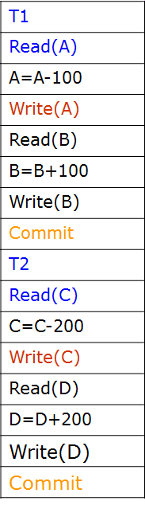
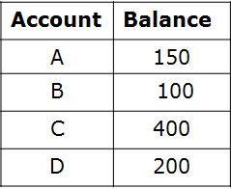
Recovery using Log Entries
Consider two transactions, Transferring Rs.100/- from account A to account B and Rs. 200/- from account C to D

Slide 226
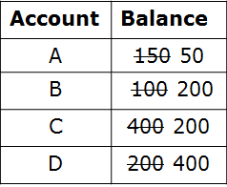
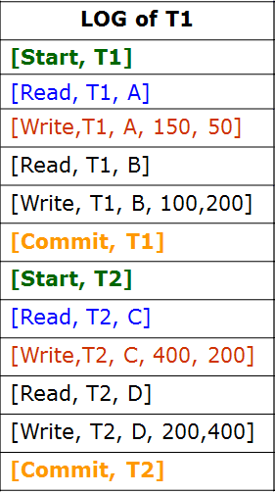
Recovery using Log Entries
Consider two transactions, Transferring Rs.100/- from account A to account B and Rs. 200/- from account C to D

Slide 227
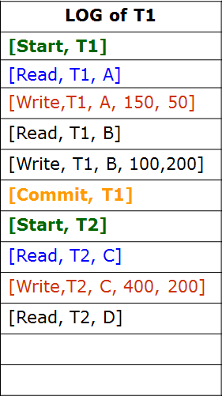
Recovery using Log Entries
Consider two transactions, Transferring Rs.100/- from account A to account B and Rs. 200/- from account C to D
Question:
Why we should maintain
New value
in LOG for write operation
System
Crash

Slide 228
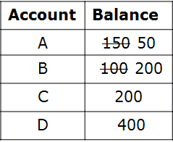
Recovery using Log Entries
Consider two transactions, Transferring Rs.100/- from account A to account B and Rs. 200/- from account C to D
REDO
New value is required for
REDO operation in
Case where you have
Reached commit point of
Transaction but
Changes where not
Updated
To database table
System
Crash

Slide 229
Recovery using Log Entries
1. Old value in LOG is required For UNDO operation
Old value is required for UNDO, If changes where made to database
Before transaction reaches commit
2. New value in LOG is required For REDO operation
New value is required for REDO operation in Case where we have Reached commit point of Transaction but Changes where not Updated To database table.

Slide 230
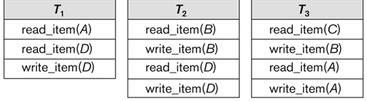
Recovery using LOG enteries
Consider three transactions T1, T2, T3 as follows
Database
A | 30
B | 15
C | 40
D | 20

Slide 231
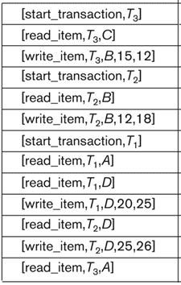
Recovery using LOG enteries
Consider three transactions T1, T2, T3 as follows
Database
A | 30
B | 15
C | 40
D | 20

Slide 232
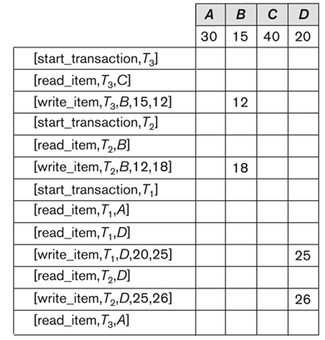
Recovery using LOG enteries
Consider three transactions T1, T2, T3 as follows
Database
A | 30
B | 15 12 18
C | 40
D | 20 25 26
System
Crash

Slide 233
Recovery using LOG enteries
Consider three transactions T1, T2, T3 as follows
Database
A | 30
B | 15 12 18
C | 40
D | 20 25 26
Question:
After System, how can we recovery
Database i.e
B value to 15,
D value to 20
System
Crash

Slide 234
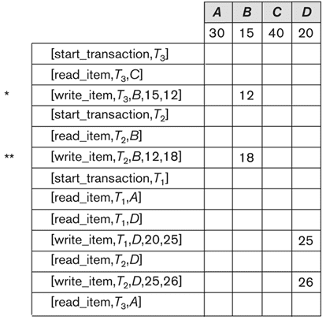
Recovery using LOG enteries
Consider three transactions T1, T2, T3 as follows
* T3 transaction is rolled back because
it did not reached its commit point
** T2 is rolled back because it reads the value of item B written by T3
Database
A | 30
B | 15 12 18 15
C | 40
D | 20 25 26
System
Crash

Slide 235
Recovery using LOG enteries
Consider three transactions T1, T2, T3 as follows
Question:
Can you answer now, why we maintain
Data item name and transaction number
For read operation in LOG ?
Database
A | 30
B | 15 12 18
C | 40
D | 20 25 26
System
Crash

Slide 236
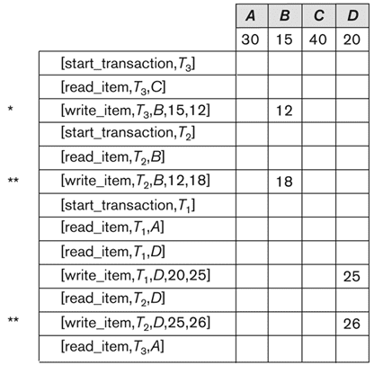
Recovery using LOG enteries
Consider three transactions T1, T2, T3 as follows
T3 and T1 transaction is rolled back because it did not reached its commit point
T2 is rolled back because it reads the value of item
- B written by T3
- D written by T1
Database
A | 30
B | 15 12 18 15
C | 40
D | 20 25 26 20
System
Crash

Slide 237
Problem to Solve
Consider the following example of log for two transactions.
1. (Start, T1);
2. (Write, T1, Q, 100,50);
3. (Commit, T1);
4. (Start, T2);
5. (Write, T2, P, 55, 10);
6. (Commit, T2);
Consider the case where the schedule crashes after Step 4 and before Step 5, then the question is which operation should we REDO if following is the scenario of database just before crash.
Q | 100
P | 55
Database

Slide 238
Answer
Consider the following example of log for two transactions.
1. (Start, T1);
2. (Write, T1, Q, 100,50);
3. (Commit, T1);
4. (Start, T2);
5. (Write, T2, P, 55, 10);
6. (Commit, T2);
Consider the case where the schedule crashes after Step 4 and before Step 5, then the question is which operation should we REDO if following is the scenario of database just before crash.
Q | 100 50
P | 55
REDO from LOG
Replacing old
Value with
New value
Database

Slide 239
Problem to Solve
Consider the following example of log for two transactions.
1. (Start, T1);
2. (Write, T1, Q, 100,50);
3. (Commit, T1);
4. (Start, T2);
5. (Write, T2, P, 55, 10);
6. (Commit, T2);
Consider the case where the schedule crashes after Step 5 and before Step 6, then the question is which operation should we UNDO if following is the scenario of database just before crash.
Q | 100 50
P | 55 10
Database

Slide 240
Answer
Consider the following example of log for two transactions.
1. (Start, T1);
2. (Write, T1, Q, 100,50);
3. (Commit, T1);
4. (Start, T2);
5. (Write, T2, P, 55, 10);
6. (Commit, T2);
Consider the case where the schedule crashes after Step 5 and before Step 6, then the question is which operation should we UNDO if following is the scenario of database just before crash.
Q | 100 50
P | 55 10 55
UNDO from LOG
Replace
New value with
Old value
Database

Slide 241
Approaches to Recovery
Two Types using LOG enteries
Deferred Update
Immediate Update

Slide 242
Log-Based Recovery
A log is kept on stable storage.
The log is a sequence of log records, and maintains a record of update activities on the database.
When transaction Ti starts, it registers itself by writing a <Ti start> log record
Before Ti executes write(X), a log record <write,Ti,X,V1,V2> is written, where V1 is the value of X before the write, and V2 is the new value to be written to X.
Log record notes that Ti has performed a write on data item X that had value V1 before the write, and will have value V2 after the write.
When Ti finishes it last statement, the log record <Commit Ti> is written.
We assume for now that log records are written directly to stable storage (that is, they are not buffered)

Slide 243
Deferred Database Modification
The deferred database modification scheme records all modifications to the log, but defers all the writes to after partial commit.
Assume that transactions execute serially
Transaction starts by writing <start Ti> record to log.
A write(X) operation results in a log record <write,Ti,X,V1,V2> being written, where V1 is old value of X, V2 is the new value for X
Note: old value V1 is not needed for this scheme
The write is not performed on X at this time, but is deferred.
When Ti partially commits, <Commit, Ti> is written to the log
Finally, the log records are read and used to actually execute the previously deferred writes.
During recovery after a crash, a transaction needs to be redone if and only if both <start Ti> and <commit Ti> are there in the log.
Redoing a transaction Ti ( redoTi) sets the value of all data items updated by the transaction to the new values.
Crashes can occur while: the transaction is executing the original updates or while recovery action is being taken
Deferred modification is also referred as No-Undo/Redo method

Slide 244
Deferred Database Modification
Example of Deferred based recovery
Consider log entries for two transactions T1 and T2 as follows.
LOG
(Start, T1)
(Write, T1, Q, 100,50)
(Commit, T1)
(Start, T2)
(Write, T2, P, 55, 10)
Database
Q | 100
P | 55
System
Crash
Under deferred recovery method, after system crash the
algorithm looks at LOG enteries for all transactions Ti if the entry of
both <start, Ti> and <commit, Ti> is present then for all write
operations REDO will be carried out i.e., replacing with new value

Slide 245
Deferred Database Modification
Example of Deferred based recovery
Consider log entries for two transactions T1 and T2 as follows.
LOG
(Start, T1)
(Write, T1, Q, 100,50)
(Commit, T1)
(Start, T2)
(Write, T2, P, 55, 10)
Database
RECOVERY after
System Crash
Q | 100 50
P | 55
REDO
System
Crash
Under deferred recovery method, after system crash the
algorithm looks at LOG enteries for all transactions Ti if the entry of
both <start, Ti> and <commit, Ti> is present then for all write
operations REDO will be carried out i.e., replacing with new value

Slide 246
Deferred Database Modification
Question:
If following is the LOG on stable storage after systems crash,
then recovery algorithm should carry out any REDO operation ?
<Start, T1>
<write,T1,A,1000,950>
<write,T1,B,2000,2050>
Database
A | 1000
B | 2000

Slide 247
Deferred Database Modification
Question:
If following is the LOG on stable storage after systems crash,
then recovery algorithm should carry out any REDO operation ?
<Start, T1>
<write,T1,A,1000,950>
<write,T1,B,2000,2050>
Database
A | 1000
B | 2000
Answer:
No REDO operation need to be taken because no commit
LOG entry found for any transaction

Slide 248
Deferred Database Modification
Question:
If following is the LOG on stable storage after systems crash,
then recovery algorithm should carry out any REDO operation ?
<Start, T1>
<write,T1,A,1000,950>
<write,T1,B,2000,2050>
<Commit, T1>
<Start, T2>
<write,T2,C,700,600>
Database
A | 1000
B | 2000
C | 700

Slide 249
Deferred Database Modification
Question:
If following is the LOG on stable storage after systems crash,
then recovery algorithm should carry out any REDO operation ?
<Start, T1>
<write,T1,A,1000,950>
<write,T1,B,2000,2050>
<Commit, T1>
<Start, T2>
<write,T2,C,700,600>
Database
A | 1000 950
B | 2000 2050
C | 700
Answer:
REDO operation for transaction T1 to data items A and B
should be performed because commit LOG entry found for
the transaction T1 <Commit, T1>

Slide 250
Deferred Database Modification
Question:
If following is the LOG on stable storage after systems crash,
then recovery algorithm should carry out any REDO operation ?
<Start, T1>
<write,T1,A,1000,950>
<write,T1,B,2000,2050>
<Commit, T1>
<Start, T2>
<write,T2,C,700,600>
<Commit, T2>
Database
A | 1000
B | 2000
C | 700

Slide 251
Deferred Database Modification
Question:
If following is the LOG on stable storage after systems crash,
then recovery algorithm should carry out any REDO operation ?
<Start, T1>
<write,T1,A,1000,950>
<write,T1,B,2000,2050>
<Commit, T1>
<Start, T2>
<write,T2,C,700,600>
<Commit, T2>
Database
A | 1000 950
B | 2000 2050
C | 700 600
Answer:
REDO operation for Transaction T1 must be performed
followed by the transaction T2 since <Commit, T1> and <Commit,T2>
are present.

Slide 252
Immediate Database Modification
The immediate database modification scheme allows database updates of an uncommitted transaction to be made as the writes are issued
since undoing may be needed, update logs must have both old value and new value
Update log record must be written before database item is written
We assume that the log record is output directly to stable storage
Can be extended to postpone log record output, so as long as prior to execution of an output(B) operation for a data block B, all log records corresponding to items B must be flushed to stable storage
Output of updated blocks can take place at any time before or after transaction commit
Order in which blocks are output can be different from the order in which they are written.

Slide 253
Immediate Database Modification
Recovery procedure has two operations instead of one:
undo(Ti) restores the value of all data items updated by Ti to their old values, going backwards from the last log record for Ti
redo(Ti) sets the value of all data items updated by Ti to the new values, going forward from the first log record for Ti
Both operations must be idempotent
That is, even if the operation is executed multiple times the effect is the same as if it is executed once
Needed since operations may get re-executed during recovery
When recovering after failure:
Transaction Ti needs to be undone if the log contains the <start, Ti> record , but does not contain the <commit, Ti> record .
Transaction Ti needs to be redone if the log contains both the <start, Ti> record and <commit, Ti> the record .
Undo operations are performed first, then redo operations.

Slide 254
Immediate Database Modification
Two main categories of Immediate update algorithm
UNDO/No-REDO
If the recovery technique ensures that all updates of a transaction are recorded in the database on disk before the transaction commits, there is never a need to redo any operations of committed transactions. Such an algorithm is called undo/no-redo.
UNDO/REDO
On the other hand, if the transaction is allowed to commit before all its changes are written to the database, we have the undo/redo method, the most general recovery algorithm.

Slide 255
Immediate Database Modification
Example of Immediate database recovery
Consider log entries for two transactions T1 and T2 as follows.
LOG
(Start, T1)
(Write, T1, Q, 100,50)
(Commit, T1)
(Start, T2)
(Write, T2, P, 55, 10)
Database
Q | 100 50
P | 55 10
System
Crash
Under immediate recovery method, after system crash the
algorithm looks at LOG enteries for all transactions Ti
- if the entry of both <start, Ti> and <commit, Ti> is present then for all write
operations of Ti REDO will be carried out if updates have not been carried out on stable storage
of database
- if the entry of only <start, Ti> is present but not <commit, Ti> then for all write
operations of Ti UNDO will be carried out

Slide 256
Deferred Database Modification
Example of Deferred based recovery
Consider log entries for two transactions T1 and T2 as follows.
LOG
(Start, T1)
(Write, T1, Q, 100,50)
(Commit, T1)
(Start, T2)
(Write, T2, P, 55, 10)
Database
RECOVERY after
System Crash
Q | 100 50
P | 55 10 55
UNDO
System
Crash
Under immediate recovery method, after system crash the
algorithm looks at LOG enteries for all transactions Ti
- if the entry of both <start, Ti> and <commit, Ti> is present then for all write
operations of Ti REDO will be carried out if updates have not been carried out on stable storage
of database
- if the entry of only <start, Ti> is present but not <commit, Ti> then for all write
operations of Ti UNDO will be carried out

Slide 257
Immediate Database Modification
Question:
If following is the LOG and database on stable storage after systems crash,
then recovery algorithm should carry out any UNDO/REDO operation ?
<Start, T1>
<write,T1,A,1000,950>
<write,T1,B,2000,2050>
Database
A | 1000 950
B | 2000 2050

Slide 258
Immediate Database Modification
Question:
If following is the LOG and database on stable storage after systems crash,
then recovery algorithm should carry out any UNDO/REDO operation ?
<Start, T1>
<write,T1,A,1000,950>
<write,T1,B,2000,2050>
Database
A | 1000 950 1000
B | 2000 2050 2000
Answer:
UNDO for T1 because <commit,T1> not found: A should be restored
to 1000 and B should be restored to 2000

Slide 259
Immediate Database Modification
Question:
If following is the LOG and database on stable storage after systems crash,
then recovery algorithm should carry out any UNDO/REDO operation ?
<Start, T1>
<write,T1,A,1000,950>
<write,T1,B,2000,2050>
<Commit, T1>
<Start, T2>
<write,T2,C,700, 600>
Database
A | 1000 950
B | 2000 2050
C | 700 600

Slide 260
Immediate Database Modification
Question:
If following is the LOG and database on stable storage after systems crash,
then recovery algorithm should carry out any UNDO/REDO operation ?
<Start, T1>
<write,T1,A,1000,950>
<write,T1,B,2000,2050>
<Commit, T1>
<Start, T2>
<write,T2,C,700, 600>
Database
A | 1000 950
B | 2000 2050
C | 700 600 700
Answer:
Recovery actions
UNDO T2 because <commit, T2> not found: C is restored to 700

Slide 261
Immediate Database Modification
Question:
If following is the LOG and database on stable storage after systems crash,
then recovery algorithm should carry out any UNDO/REDO operation ?
<Start, T1>
<write,T1,A,1000,950>
<write,T1,B,2000,2050>
<Commit, T1>
<Start, T2>
<write,T2,C,700, 600>
<Commit, T2>
Database
A | 1000
B | 2000
C | 700

Slide 262
Immediate Database Modification
Question:
If following is the LOG and database on stable storage after systems crash,
then recovery algorithm should carry out any UNDO/REDO operation ?
<Start, T1>
<write,T1,A,1000,950>
<write,T1,B,2000,2050>
<Commit, T1>
<Start, T2>
<write,T2,C,700, 600>
<Commit, T2>
Database
A | 1000 950
B | 2000 2050
C | 700 600
Answer:
Recovery actions
REDO operation for Transaction T1 and T2 since <Commit, T1> and
<Commit,T2> are present.

Slide 263
Checkpoints
Problems in recovery procedure as discussed earlier :
1.Searching the entire log is time-consuming
2.We might unnecessarily redo transactions which have already
output their updates to the database.
Streamline recovery procedure by periodically performing checkpointing
1.Output all log records currently residing in main memory onto stable storage.
2.Output all modified buffer blocks to the disk.
3.Write a log record <checkpoint> onto stable storage.

Slide 264
Checkpoints
During recovery we need to consider only the most recent transaction Ti that started before the checkpoint, and transactions that started after Ti.
1. Scan backwards from end of log to find the most recent <checkpoint> record
2. Continue scanning backwards till a record <start Ti> is found.
3.Need only consider the part of log following above start record. Earlier part of log can be ignored during recovery, and can be erased whenever desired.
4.For all transactions (starting from Ti or later) with no < commit Ti>, execute undo(Ti). (Done only in case of immediate modification.)
5.Scanning forward in the log, for all transactions starting from Ti or later with a <commit Ti>, execute redo(Ti).

Slide 265
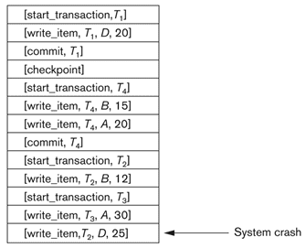
Recovery using Deferred Update with Concurrent Transactions
Consider the following LOG enteries
T2 and T3 are ignored because they did not reach their commit points
T4 is redone because its commit point is after the last system check point

Slide 266
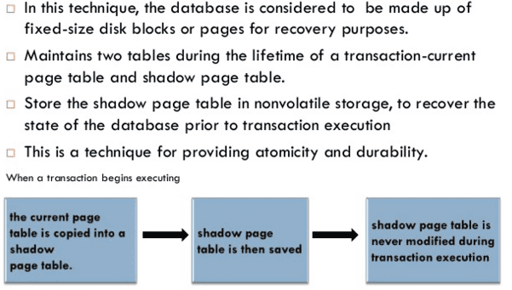
Shadow Paging: Recovery Scheme that does not require log and useful for single-user environment

Slide 267
Shadow Paging
Hard Disk
Database table
PageNo. | Page/ Sub-table Data | Location
1 | Data Item A 1000 | Addr1
2 | B 2000 | Addr2
3 | C 700 | Addr3
4 | D 50 | Addr4

Slide 268
Shadow Paging
Hard Disk
Database table
PageNo. | Page/ Sub-table Data | Location
1 | Data Item A 1000 | Addr1
2 | B 2000 | Addr2
3 | C 700 | Addr3
4 | D 50 | Addr4
Transaction operations
(Start,T1)
(Write,T1,A,1000,950)
(Write,T1,B,2000,2050)
(Commit,T1)
(Start, T2)
(Write,T2,C,700,600)
(Write,T2,D, 50,30)

Slide 269
Shadow Paging
Hard Disk
Database table
Main Memory
PageNo. | Page/ Sub-table Data | Location
1 | Data Item A 1000 | Addr1
2 | B 2000 | Addr2
3 | C 700 | Addr3
4 | D 50 | Addr4
Current Page
Directory
Page 1: Addr1
Page 2: Addr2
Page 3: Addr3
Page 4: Addr4
Transaction operations
(Start,T1)
(Write,T1,A,1000,950)
(Write,T1,B,2000,2050)
(Commit,T1)
(Start, T2)
(Write,T2,C,700,600)
(Write,T2,D,50,30)
When transaction starts
Current Page directory is
kept in main memory and
Shadow directory on disk
Shadow Page Directory
Page 1: Addr1
Page 2: Addr2
Page 3: Addr3
Page 4: Addr4

Slide 270
Shadow Paging
Hard Disk
Database table
Main Memory
PageNo. | Page/ Sub-table Data | Location
1 | Data Item A 1000 | Addr1
2 | B 2000 | Addr2
3 | C 700 | Addr3
4 | D 50 | Addr4
5 | A 950 | Addr5
Current Page
Directory
Page 1: Addr1 Addr5
Page 2: Addr2
Page 3: Addr3
Page 4: Addr4
Transaction operations
After execution of
(write,T1,A,1000,950)
Then new page table
is created on disk and
Current page
Directory updated.
But shadow directory will
not be updated
(Start,T1)
(Write,T1,A,1000,950)
(Write,T1,B,2000,2050)
(Commit,T1)
(Start, T2)
(Write,T2,C,700,600)
(Write,T2,D,50,30)
Shadow Page Directory
Page 1: Addr1
Page 2: Addr2
Page 3: Addr3
Page 4: Addr4

Slide 271
Shadow Paging
Hard Disk
Database table
Main Memory
PageNo. | Page/ Sub-table Data | Location
1 | Data Item A 1000 | Addr1
2 | B 2000 | Addr2
3 | C 700 | Addr3
4 | D 50 | Addr4
5 | A 950 | Addr5
6 | B 2050 | Addr6
Current Page
Directory
Page 1: Addr1 Addr5
Page 2: Addr2 Addr6
Page 3: Addr3
Page 4: Addr4
Transaction operations
After execution of
(write,T2,2000,2050)
Then new page table
is created on disk and
Current page
Directory updated.
But shadow directory will
not be updated
(Start,T1)
(Write,T1,A,1000,950)
(Write,T1,B,2000,2050)
(Commit,T1)
(Start, T2)
(Write,T2,C,700,600)
(Write,T2,D,50,30)
Shadow Page Directory
Page 1: Addr1
Page 2: Addr2
Page 3: Addr3
Page 4: Addr4

Slide 272
Shadow Paging
Hard Disk
Database table
Main Memory
PageNo. | Page/ Sub-table Data | Location
1 | Data Item A 1000 | Addr1
2 | B 2000 | Addr2
3 | C 700 | Addr3
4 | D 50 | Addr4
5 | A 950 | Addr5
6 | B 2050 | Addr6
Current Page
Directory
Page 1: Addr1 Addr5
Page 2: Addr2 Addr6
Page 3: Addr3
Page 4: Addr4
Transaction operations
After execution of
(commit,T1)
Shadow directory will
be updated and old page
On the hard disk will be
discarded
(Start,T1)
(Write,T1,A,1000,950)
(Write,T1,B,2000,2050)
(Commit,T1)
(Start, T2)
(Write,T2,C,700,600)
(Write,T2,D,50,30)
Shadow Page Directory
Page 1: Addr1 Addr5
Page 2: Addr2 Addr6
Page 3: Addr3
Page 4: Addr4

Slide 273
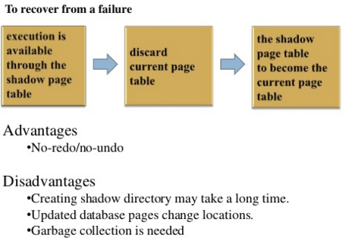
Shadow Paging

Slide 274
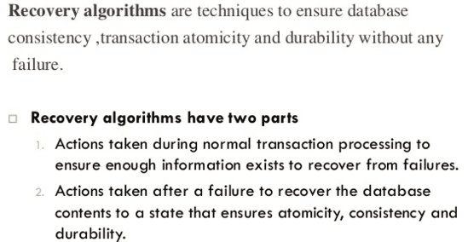
“ARIES” recovery algorithm

Slide 275
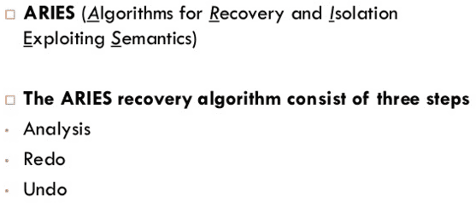
“ARIES” recovery algorithm

Slide 276
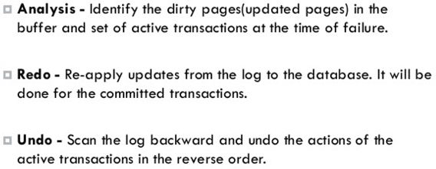
“ARIES” recovery algorithm

Slide 277
Next we will learn Deadlocks
Deadlocks occur when each transaction T in a set of two or more transactions is waiting for some item that is locked by some other transaction T’ in the set.

Slide 278
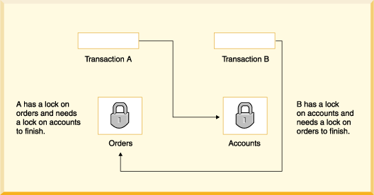
Illustrating Deadlock Problem
Transaction A | Transaction B
Read_lock(orders)
Read_item(orders)
 | Read_lock(accounts)
 | Read_item(accounts)
Write_lock(accounts) (wait for accounts)
 | Write_lock(oders) (wait for oders)
Deadlock between
Transaction A and B

Slide 279
Approaches for dealing with deadlocks
1.Deadlock Prevention Protocols
1.1. Based on Timestamp
1.1.1. Wait-Die
1.1.2. Wound-Wait
1.2 Without using timestamp
1.2.1. No-waiting
1.2.2. Cautious waiting
2. Deadlock Detection Protocols
2.1. Using wait-for graph
3. Timeouts

Slide 280
Deadlock Prevention Protocols
Based on Timestamp: 1. Wait-Die 2.Wound-Wait
Suppose Ti tries to lock an item X but is not able because X is
locked by some other transaction Tj.
1. wait-die:
If TS(Ti) < TS(Tj), then (Ti older than Tj), Ti is allowed to wait
Otherwise (Ti younger than Tj) abort & rollback Ti and restart it using the same timestamp
2. wound-wait:
If TS(Ti) < TS(Tj), then (Ti older than Tj), abort & rollback Tj, and restart it using the same timestamp
Otherwise (Ti younger than Tj), Ti is allowed to wait
4:00pm, Older Transaction To | 4:05pm, Younger transaction Ty
Then To waits | If Ty holds X
If To holds X | Then Ty is discarded (die)
4:00pm, Older Transaction To | 4:05pm, Younger transaction Ty
If To holds X | Then Ty waits
Then To pre-empts (wounds) Ty | If Ty holds X

Slide 281
Deadlock Prevention protocol
Without using Timestamp
No-Waiting: If transaction cannot get lock it assumes deadlock. So it dies, waits and restarts later
Cautious Waiting
If transaction cannot get lock, it check the lock holder
- If lock holder is already waiting then transaction dies and restarts later
- If Lock holder is active then transaction waits

Slide 282
Deadlock Prevention protocol
Timeouts: If a transaction waits for a period longer than a system-defined timeout period, the system assumes that the transaction may deadlocked and aborts it – regardless of whether a deadlock actually exists or not

Slide 283
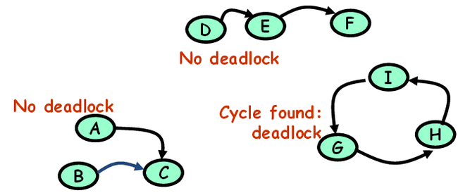
Deadlock Detection protocols
In this approach, deadlocks are allowed to happen. The scheduler maintains a wait-for-graph for detecting cycle. If a cycle exists, then one transaction involved in the cycle is selected (victim) and rolled-back.
A wait-for-graph is created using the lock table. As soon as a transaction is blocked, it is added to the graph. When a chain like: Ti waits for Tj waits for Tk waits for Ti or Tj occurs, then this creates a cycle. One of the transaction of the cycle is selected and rolled back.

Slide 284
Starvation
Starvation occurs when a particular transaction consistently waits or restarted and never gets a chance to proceed further.
In a deadlock resolution it is possible that the same transaction may consistently be selected as victim and rolled-back.
This limitation is inherent in all priority based scheduling mechanisms.
In Wound-Wait scheme a younger transaction may always be wounded (aborted) by a long running older transaction which may create starvation.
The algorithm can use higher priorities for transactions that have been aborted multiple times to avoid starvation problem.

Slide 285
Approaches for dealing with deadlocks
1.Deadlock Prevention Protocols
1.1. Based on Timestamp
1.1.1. Wait-Die
1.1.2. Wound-Wait
1.2 Without using timestamp
1.2.1. No-waiting
1.2.2. Cautious waiting
2. Deadlock Detection Protocols
2.1. Using wait-for graph
3. Timeouts

Slide 286
Thanks for Listening

